Slide 1



The LARC Quality Improvement Collaborative:
Learning Session I
How to be a Quality Ninja
LARC

Slide 2
WHY
Quality Improvement
Notes:
Why does quality matter?

Slide 3
It is all about CHANGE!
Old Process
Tests of CHANGE
Multiple PDSAs
Implement the New CHANGE
Sustain the New CHANGE

Slide 4
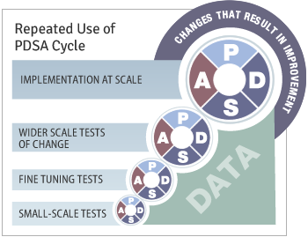
Quality Improvement
Overview
Old Process
Tests of CHANGE
Multiple PDSAs
Implement the New CHANGE
Sustain the New CHANGE
Define
Measure
Analyze
Improve
Control

Slide 5
Quality Improvement
“The combined and unceasing efforts of everyone—healthcare professionals, patients and their families, researchers, payers, planners and educators—to make the changes that will lead to better patient outcomes (health), better system performance (care) and better professional development.”
                Paul B. Batalden and Frank Davidoff
Qual Saf Health Care. 2007 Feb; 16(1): 2–3.

Slide 6
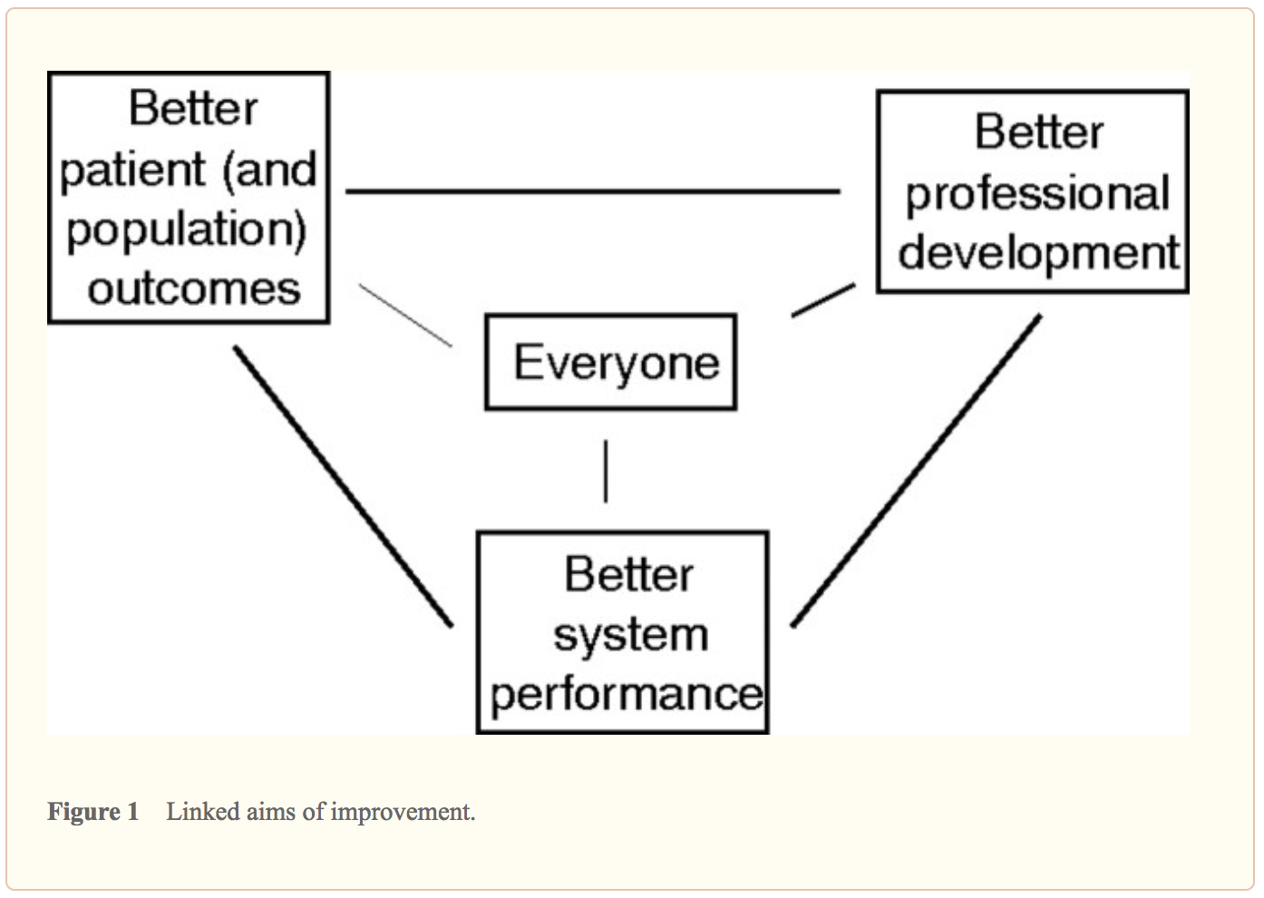
What is “quality improvement” and how can it transform healthcare?
Qual Saf Health Care.
2007 Feb; 16(1): 2–3.
Notes:
Focus on these three components - Moving to How QI achieved…focus on these three components to share some examples of

Slide 7
WHY
LARC
Notes:
Why does quality matter?

Slide 8
The great aim of education is not knowledge, but action!
Herbert Spencer

Slide 9
LARC = ACTION
Introduction: Webinar
Session I: Define Measure Analyze
Session II: Simulation Improve
Smart Start: On-Site Session
Session III: Control Share/Report
Final Report
Total
= 6-9
Months
2 Months
1 Week
2-3 months
2-3 months
1 Month
Preparation
Project Outline
Action Period
Action Period
Report Completion
Notes:
Key elements of a learning collaborative
Focused on one opportunity
Expertise
Learn from each other

Slide 10
Purpose/Expectations:
To create an improvement culture where team members understand and utilize practical QI tools:
to successfully complete a QI project
and
to make continuous process improvement the way you work for the future!

Slide 11

Embed Improvement in your DNA

Slide 12






To increase the percentage of viral load samples collected from eligible patients from 45% (Jul 2016) to 80% by Aug 2017
To increase the percentage of viral load tests ordered for eligible patients from 0% (July 2016) to 80% by June 2017 in CPN, CCR, and ARV clinics
To increase the percentage of patients with viral load results placed in their files from 4% (October 2016) to 80% by June 2017
Mozambique
Malawi
Kenya
LARC Project
spread to
all Clinic
Clinician Education
All Clinic
Clinic Director Follow-up
Clinician Education began
Nationwide HCW strike
To increase the percentage of high viral load patients with documented timely follow-up from 12% (average from Dec’15 to June ‘16) to 80% by June 2017
To increase the percentage of high VL patients with a documented return visit from 35% (Oct 2016) to 100% by June 2017
To increase the percentage of high VL patients 1) contacted ≤ 1 week after results receipt from 27% to 90%, and 2) initiated with IAC ≤ 1 month from 6% to 90% between June 2016 and June 2017
Swaziland
Tanzania
Uganda
Baseline
HVL register implemented
IAC forms implemented
HVL stickers on patient files

Slide 13
WHO
Notes:
Why does quality matter?

Slide 14

Do you have what it takes to be a quality ninja?
Wear the Glasses
  See Opportunities for Improvement (OFI)
Passion for Improvement
Ability to Engage Others
See the Big Picture
  Yet also give Attention to Detail
Learn & Use Quality Improvement (QI) Tools skillfully
Outcome driven
Grit (Perseverance)
QUALITY

Slide 15
LARC Overview

Slide 16


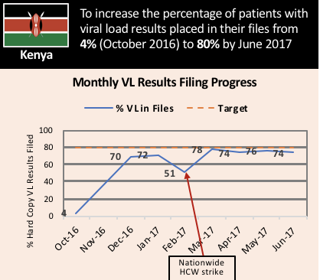
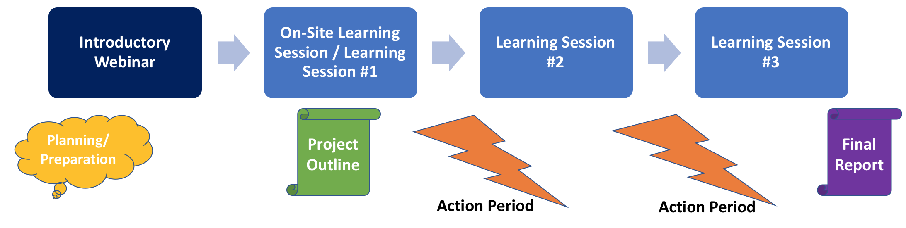
What is LARC?
Laboratory African Regional Improvement Collaborative
Bringing together multidisciplinary clinical teams to improve any process or system
CURRICULUM: Quality Improvement (QI) Methodologies |  | DELIVERY MODEL: Learning Collaborative |  | OUTCOME
Focused on QI concepts, skills, tools & implementation 30+ QI Tools with Templates Coordinated step-by-step guidance through project Just-in-time training to produce QI project deliverables |  | Introductory Webinar Smart Start + Learning Sessions Delivered over 6-9 months Action Periods Interspersed for Project Implementation Mentoring & Coaching Site Visits Learning shared among collaborative members |  | Improved Healthcare Delivery – Safer, higher-quality, client-centered Successfully Completed Project/s - Result-driven Embedded QI Concepts & Skills → Culture of Improvement

Slide 17
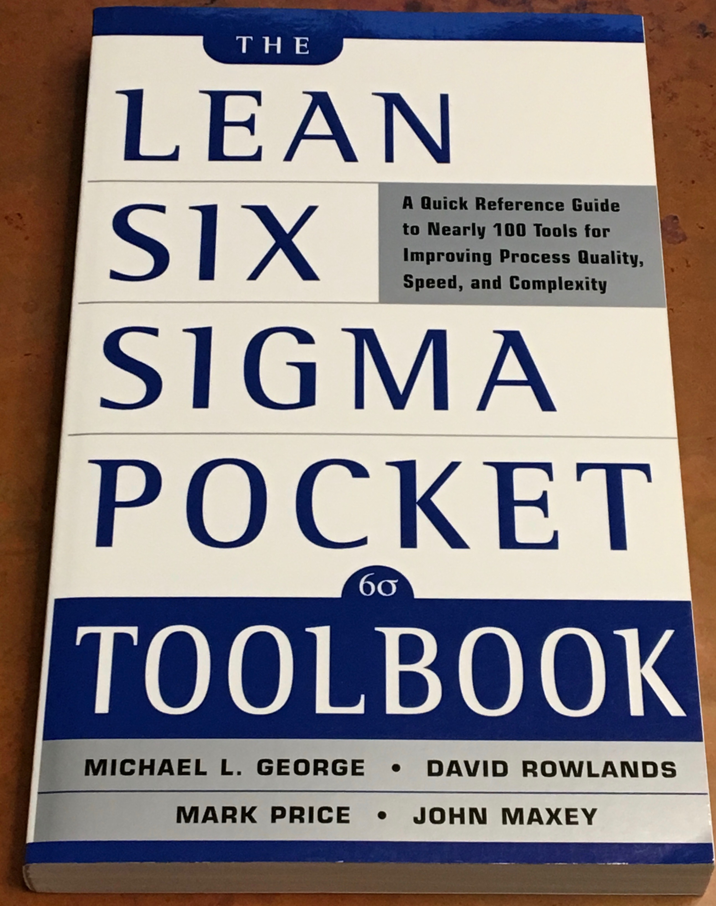
Out of nearly 100 tools/methodologies,
the Vital Few for project success
have been selected

Slide 18
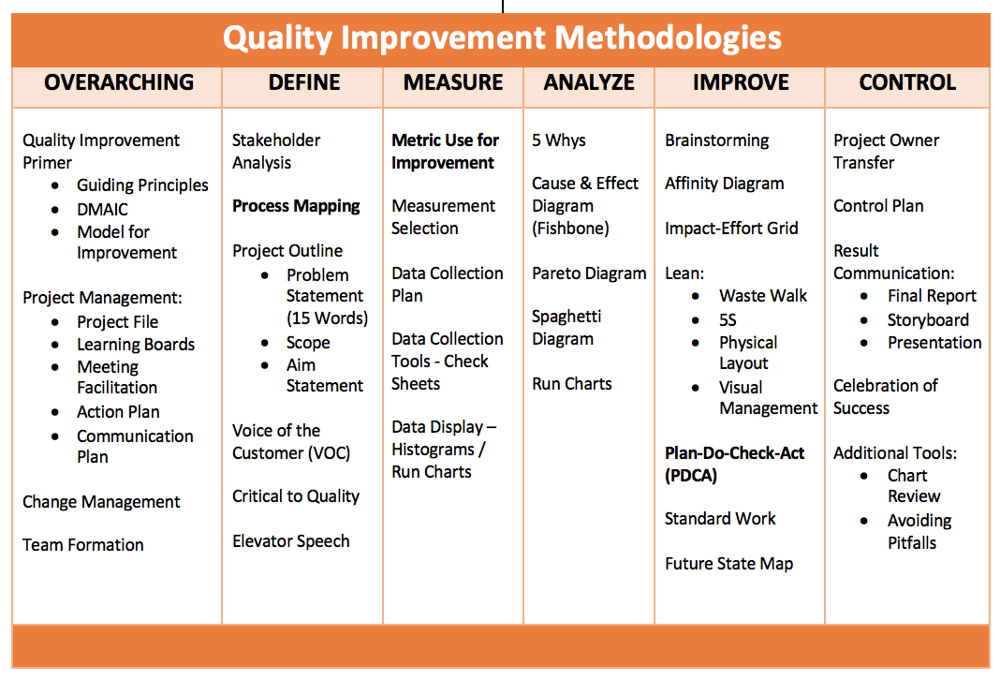

Slide 19
LARC = Quality Improvement Collaborative
Introduction: Webinar
Session I: Define Measure Analyze
Session II: Simulation Improve
Smart Start: On-Site Session
Session III: Control Share/Report
Final Report
Total
= 6-9
Months
2 Months
1 Week
2-3 months
2-3 months
1 Month
Preparation
Project Outline
Action Period
Action Period
Report Completion
Notes:
Key elements of a learning collaborative
Focused on one opportunity
Expertise
Learn from each other

Slide 20
Quality Improvement Collaborative Overview: Program Delivery
Introduction Webinar
Launch
Session I
Session II
Session III
Final Report
Smart Start
(on site)
Total Implementation Period = 6 Months
2 Months
2 months
2 months
1 Month
Project Outline
Action Period
Action Period
Action Period
Report
Completion
Preparation
Notes:
Still the collaborative model – learning sessions and action periods, but Shortened

Slide 21
SESSION | Introductory Webinar | Smart Start: 2-Day On-Site | Learning Session #1 | Learning Session #2 | Learning Session #3
CONTENT | Quality Improvement Primer - Guiding Principles DMAIC Model for Improvement Data/ Measurement Overview Stakeholder Analysis Team Formation Planning for Smart Start / Process Mapping | DEFINE / MEASURE Process Mapping Brainstorming / Affinity Diagram Prioritize Opportunities for Improvement (OFIs) Impact/Effort Grid Project Outline Problem Statement Scope Aim Statement / Metric Elevator Speech Action Plan Communication Plan | Quality Improvement Review Smart Start Outputs PDCA Overview Project Mgmt. Change Mgmt. Voice of Customer Critical to Quality Data/Measurement ANALYZE 5 Whys, Cause & Effect Diagram, Pareto Diagram, Spaghetti Diagram, Run Charts/Control Charts | IMPROVE Simulation Before/After PDCA / Small Test of Change Lean 5S Visual Management Physical Layout Standardized Work Future State Process Map Data Display | CONTROL Process Owner Transfer Control Plan Result Communication Final Report Storyboard Presentation Spread Best Practices Celebrate Success Additional Tools Chart Review Avoiding Pitfalls

Slide 22
Project Deliverables
On-Site / Session 1
DEFINE / MEASURE / ANALYZE
Session 2
IMPROVE
Session 3
CONTROL
Identify Stakeholders
Team Formation
Map the Process (Current)
ID / Prioritize Opportunities
  Project Outline
Baseline Metrics - Data Collection Tool/Plan
Action Plan
Elevator Speech
VOC Information
Root Cause Analysis
1 Rapid/Small Test of Change (PDSA)
Presentation
  Update Project Outline, if necessary
1 5S Exercise
1 Visual Management Application
2 or more Tests of Change (PDSA)
Select and Implement Change
Modify Solution(s) where necessary by additional Test of Change (PDSA)
Create Future State Map
Create Standard Work
Presentation
Update Project Outline, if necessary
Validate Solution(s) / Interventions
Create Control Plan
Transfer to Operational Owner
Share/Spread Intervention, if applicable
Final Presentation
Project Champion
Notes:
Just in Time training to accomplish deliverables

Slide 23

The LARC Quality Improvement Collaborative:
Learning Session I
How to be a Quality Ninja
Overarching
LARC

Slide 25
Quality Improvement Primer
Guiding Principles
DMAIC
Model for Improvement

Slide 26
Guiding Principles for Quality Improvement
Focus on the needs of the USERS
Focus on PROCESSES to increase the productivity of work
Use DATA to improve services
Use TEAMS to improve quality
Improve COMMUNICATION
Workbook, p. 6

Slide 27
It is all about CHANGE!
Old Process
Tests of CHANGE
Multiple PDCAs
Implement the New CHANGE
Sustain the New CHANGE

Slide 28
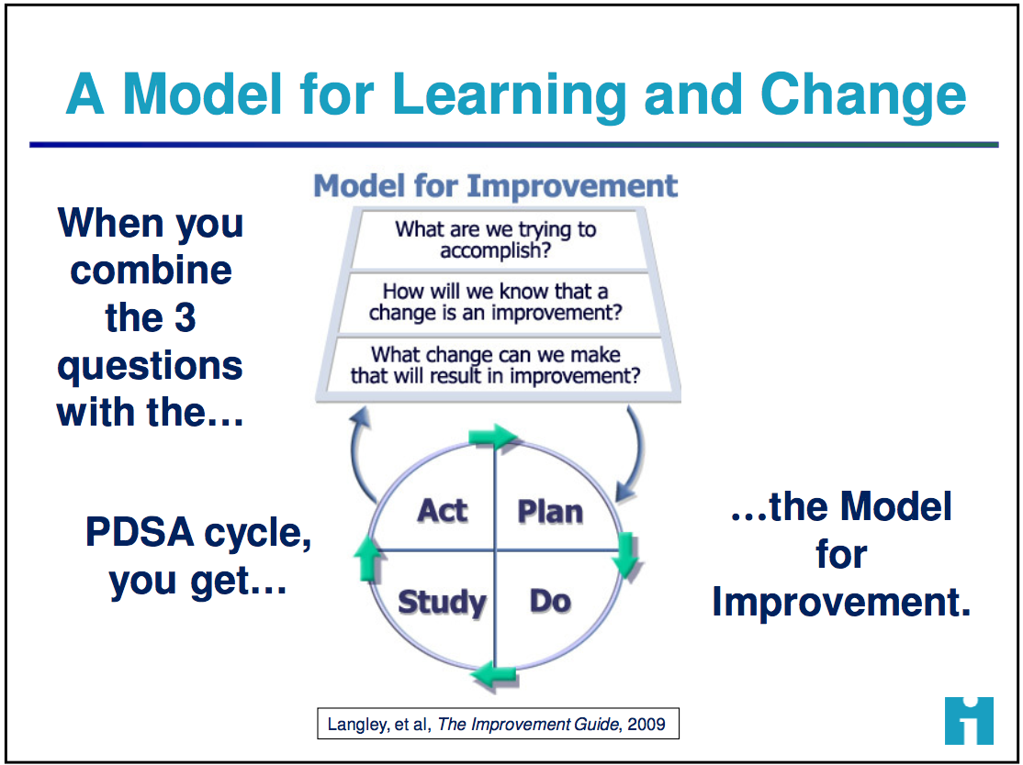
How do we create change?
3 Questions + PDCA = The Model for Improvement
Workbook, p. 8-12
Notes:
The Scientific Model for improvement

Slide 29
Quality Improvement
Overview
Old Process
Tests of CHANGE
Multiple PDSAs
Implement the New CHANGE
Sustain the New CHANGE
Define
Measure
Analyze
Improve
Control

Slide 30
DMAIC = Quality Improvement (QI) Framework
To solve complex problems or improve any process
DEFINE
What is the nature of the problem?
IMPROVE
What changes will we make to address the problem?
CONTROL
How can we sustain and spread the changes?
MEASURE
ANALYZE
What is the magnitude of the problem?
What are the most important causes of the problem?
Workbook, p. 7
Problem Statement
Goals, Aim, Timeline
& Scope
Identify Root Cause
Monitor Process
Communicate &
Share Successes
Select Metric
Collect Data
Test and
Select Changes
Notes:
This is…
A standardized, scientific evidence-based framework / approach for solving problems or improving any process
WHY:
Problems are better solved and processes are better improved using a framework / an approach that is:
Consistent, standardized for each and every complex problem and/or process requiring improvement
Scientific evidence-based versus opinion-based
Data-driven
Based on exploration and analysis of causative issues
Focused on sustainable solutions
Resultant in communication & spread (sharing) of best practices

Slide 31
Session 1 Deliverables
DEFINE / MEASURE / ANALYZE
Identify Stakeholders
Team Formation
Map the Process (Current)
ID / Prioritize Opportunities
  Project Outline
Baseline Metrics - Data Collection Tool/Plan
Action Plan
Elevator Speech
VOC Information
Root Cause Analysis
1 Rapid/Small Test of Change (PDSA)
Presentation

Slide 32
Small Test of Change = PDSA

Slide 33
The Model for Improvement (IHI)
Aim
What are we trying to accomplish?
Measure
How will we know that a change is
an improvement?
Change
What change can we make that
will result in improvement?
Small tests of change
Act
Plan
Study
Do
Notes:
Improvement techniques are Formal methods to test changes in the steps of a process and seek to achieve greater process reliability more efficiently and at less cost
- Best to use an example like weight loss
- Reliable Process-a set of steps that when performed achieves the same result with minimum variation over time. The likelihood that a process will achieve its desired outcome is dependent on the variability of each step and the total number of steps. Reliability goes down as the number of steps increase and as the variability of the steps increases
- Test of Changes
- A test of change alters a step in a process and evaluates the impact of that alteration
- There are 3 questions to ask prior to a test of change or Plan, Do, Study Act PDSA
What are we trying to accomplish?
How will we know that a change is an improvement?
What change can we make that will result in improvements?
- PDSA’s don’t result in success or failure, they generate learning
- 4 components of PDSA
- Plan-develop an action plan to run the cycle. Predict the expected result. The who, what, where, and when. Keep it simple, only one change at a time, one shift, one day, etc.
- Do-perform the action plan
- Study-evaluate the change, and whether it performed as predicted
- Act-Reflect on what happened and use the learning to begin planning for the next test of change
- How to determine what test of changes to do
- First have a clear Aim, which means the team knows what to work towards
- Reflect on the major factors or drivers that will influence achieving the goal. This helps to focus the group’s efforts and decreases the likelihood that unnecessary work will occur
- Determining the major factors or drivers helps to limit the interventions or actions to the few that are most likely to help achieve the goal.
Plan
State the objective of the cycle, what are we trying to accomplish?
Make predictions
Generate solutions
Develop the plan to carry out the cycle (who, what, where, when)
Do
Test the change
Document problems and unexpected observations
Analysis the data
Study
Complete the analysis
Compare the data to predictions
Summarize learning's
Act
Make changes to the process
Standardize the process
Select the next cycle
What change can we make that will result in improvement?

Slide 34
Model for Improvement - PDSA
ACT
PLAN
DO
STUDY

Slide 35

IHI Open School Resource

Slide 36
PDSA –
Iterative Cycles
The Rule of One - A 1:1:1 test (e.g., “1 provider, 1 patient, 1 encounter”) is a useful rule for early PDSA cycles.
The Five Times Rule says to multiply the number of encounters or events used in the last cycle by five when scaling up a test of change.
Conducting more than one test at the same time (i.e., concurrent test cycles) allows teams to explore more than one set of conditions in parallel.
Notes:
The rule of One - Why would you try to take it to a larger scale if you can’t get it to work with one individual?” I think that’s a powerful way to think about it. If I can’t get something to work for myself, why would I try to get other people to do it?

Slide 37
PDSA - Small Test of Chance (July)
ACT
PLAN
DO
CHECK
Worked well ➡️ Standardize
Did not work ➡️ Create new test of change (PDCA)
Worked partially ➡️ “Tweak” and begin PDCA #2
⬆ % of high VL patients scheduled for F/U appointment from ___ to 50%
Analyze Data (by 29 July)
  Met goal?
  Why/Why not?
Test new Daily High VL Tracking Log on Tuesdays & Thursdays 12-22 July

Slide 38
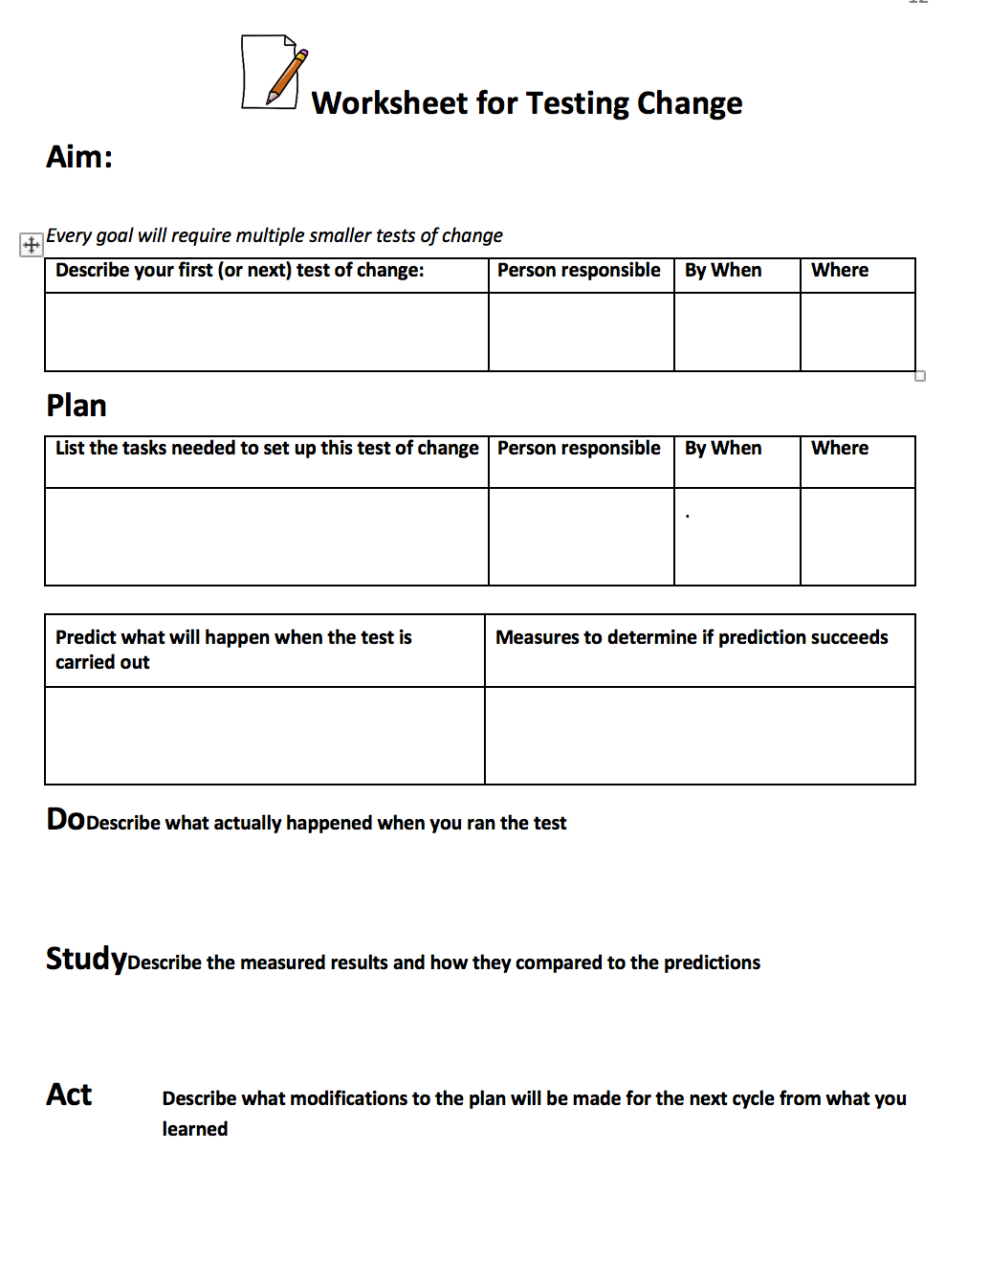
QI Workbook, p. 12

Slide 39
Project Management

Slide 40
Deliverables
Project Folder, to include:
  Process Map – Current State & Table
  Project Outline & Plans – Action & Communication
  Data – Collection Plan, Collection Tool with Raw Data; Data Display
  Solutions – PDCAs, Standard Work; Training Matrix
  Project History – Lessons learned
Learning Board
Meeting Facilitation
  Meeting Agenda
  Calendar of all Team Meetings & Learning Sessions
Action Plan
Communication Plan
Workbook, p. 15-26

Slide 41
Project Folder
Action Plan
Communica-tion Plan
Learning Board
Meeting Facilitation
Project Management:
Key Implementation Elements of a
Successful Improvement Project

Slide 42
Project Folder:
The Central Repository of Project Knowledge
Process Map / Table
Project Outline
Plans – Action & Communication
Data – Collection Plans, Logs w/ Raw Data;
Display
Solutions – PDCAs; Standard Work; Training Matrix
Project History – Lessons Learned
Workbook, p. 18

Slide 43

Learning Board
Workbook, p. 16-17

Slide 44
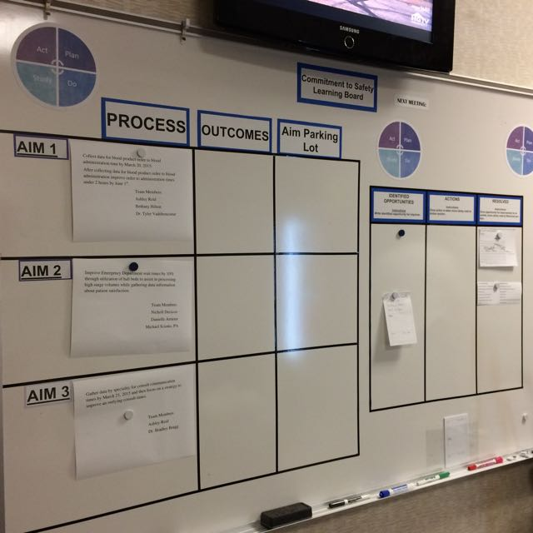
Two sides of the
Learning Board:
Project
Just Do It
Project
Just Do It

Slide 45
LEARNING BOARD
PROJECT |  |  | JUST DO IT
Aim / Metric | Changes |  | Identified Opportunities | Actions | Resolved

Slide 46
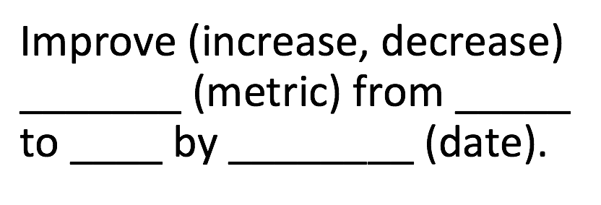
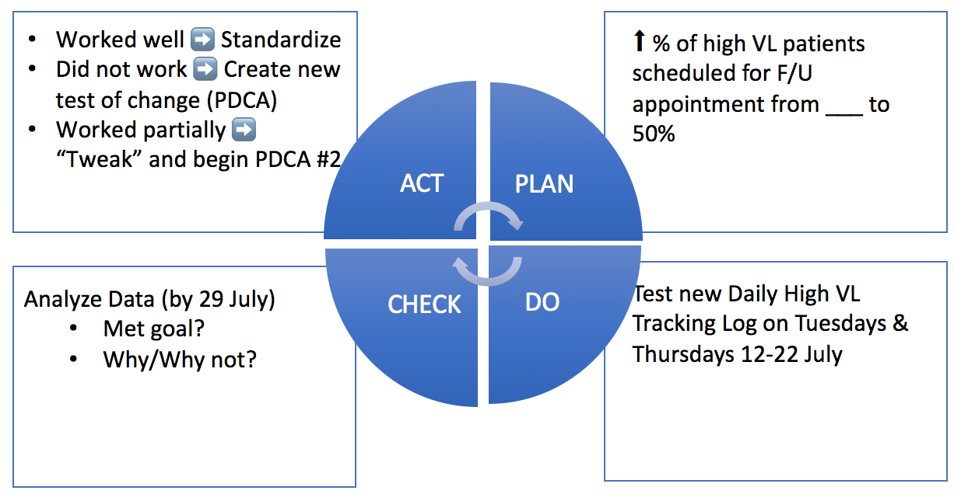
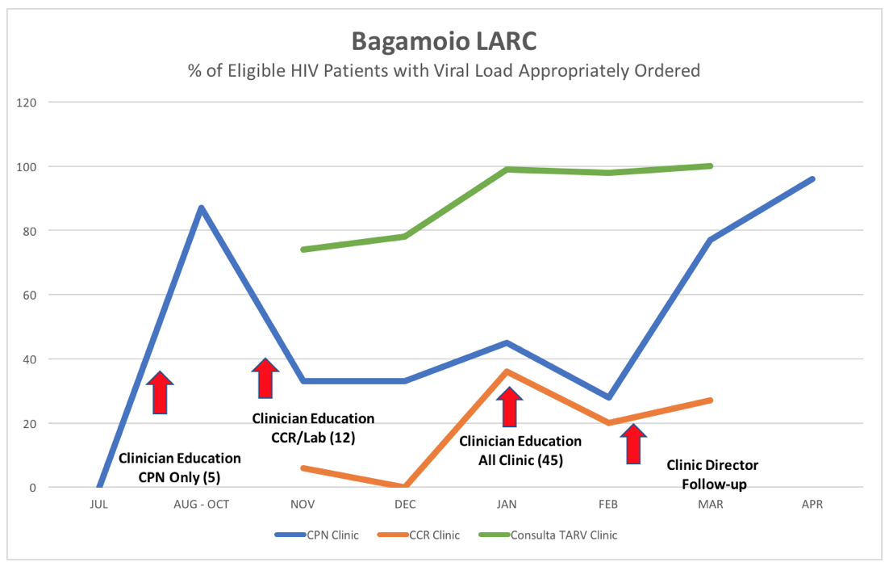
LEARNING BOARD
PROJECT |  |  | JUST DO IT
Aim / Metric | Changes |  | Identified Opportunities | Actions | Resolved

Slide 47
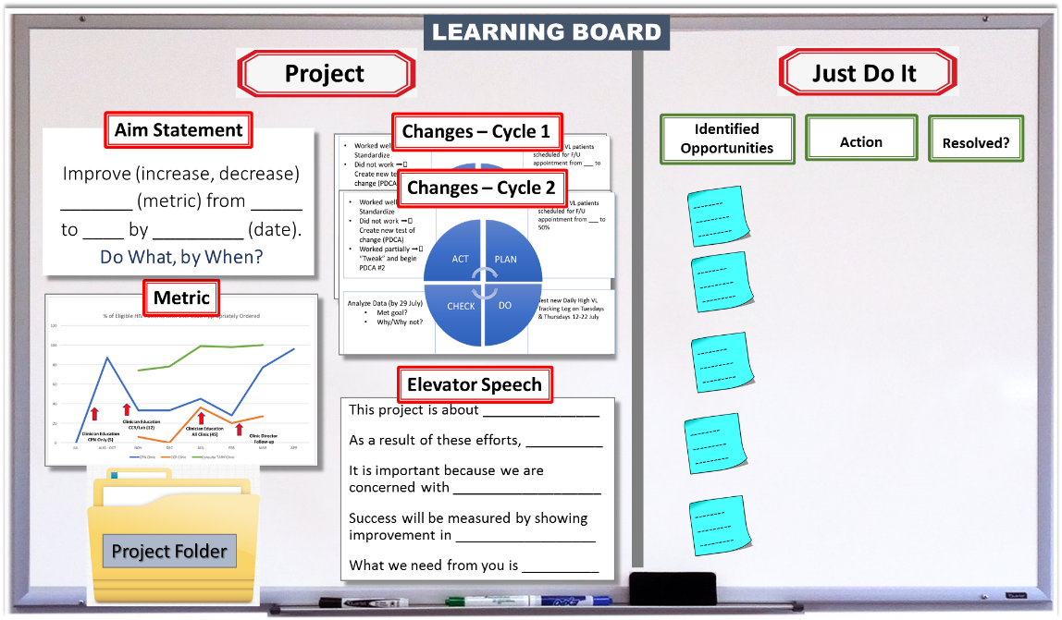

Slide 48
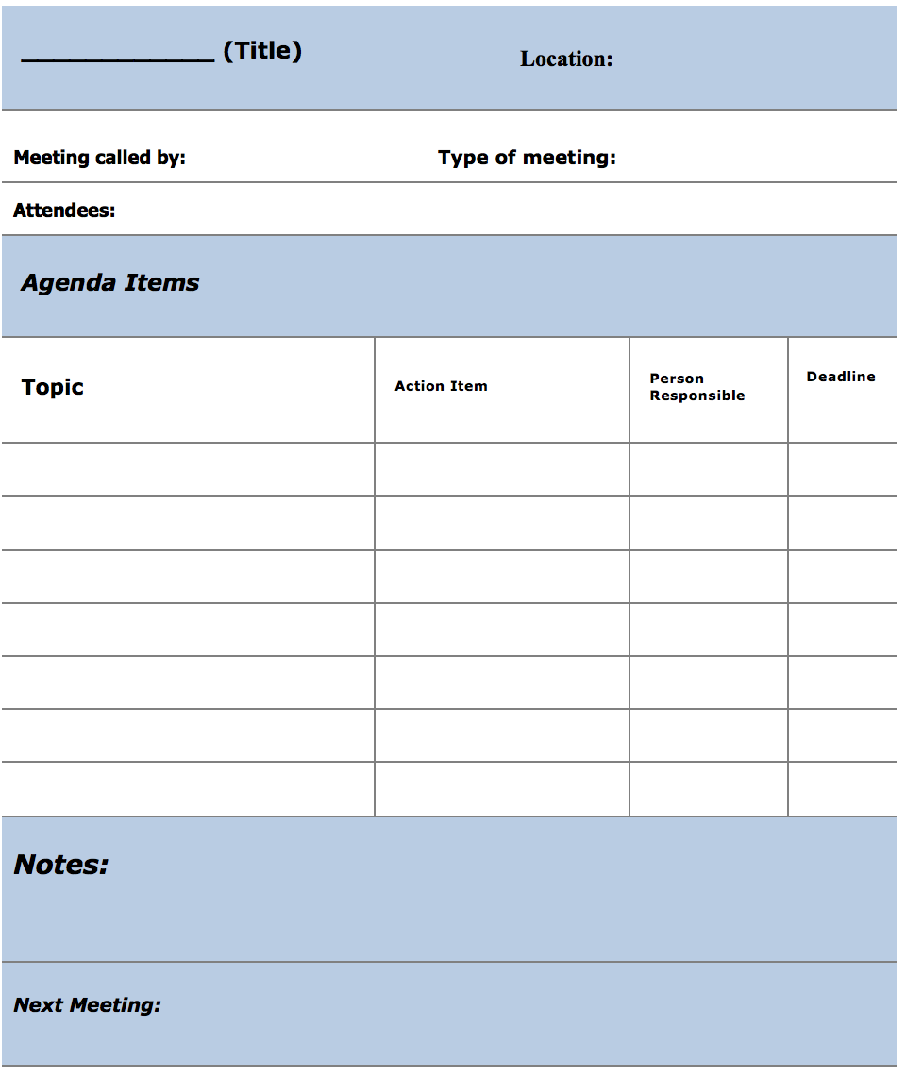
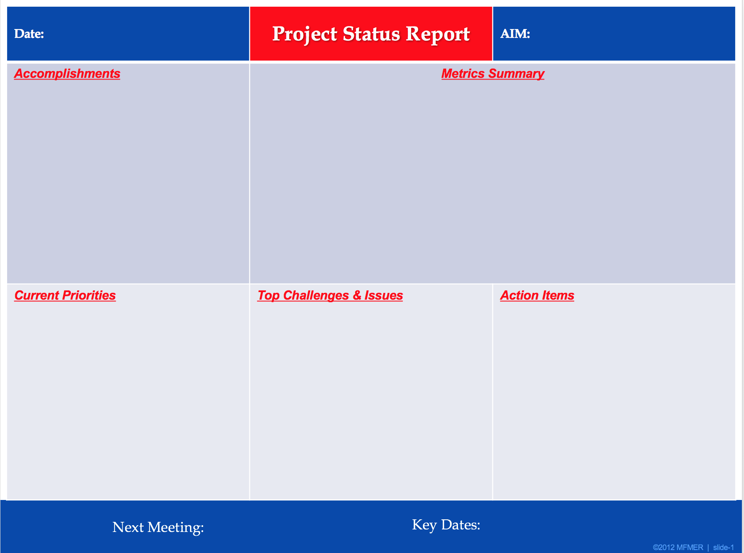
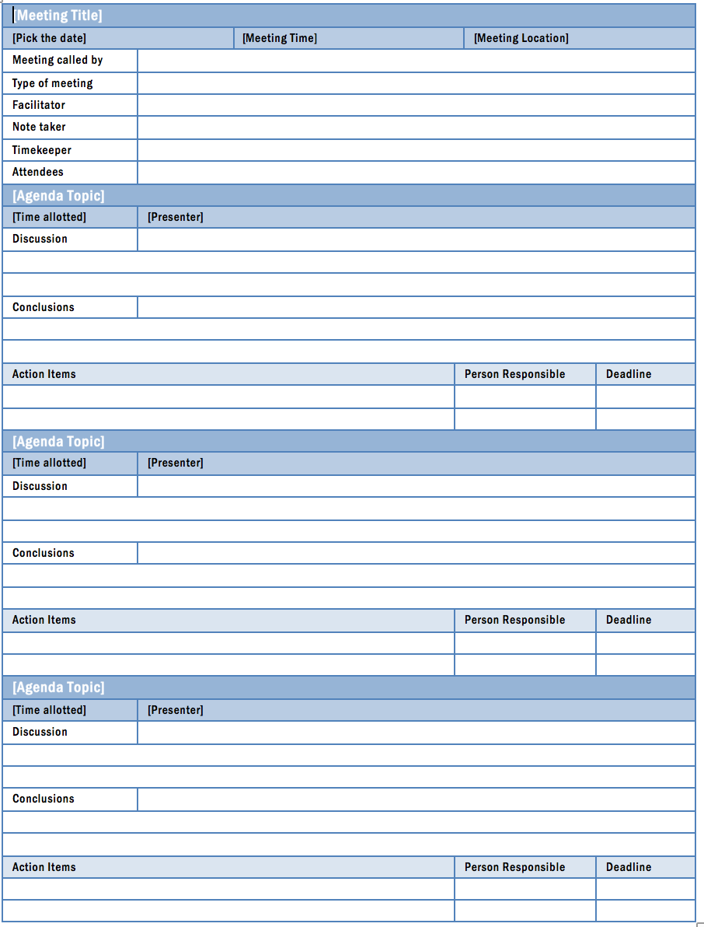
Meeting Facilitation
Workbook, p. 19-24

Slide 49
Meetings: Tips for Success
ALWAYS
  Send Agenda prior to each meeting
    Team lead to create Agenda & Review Agenda Items & Material prior to meeting
  Only invite those who need to be at the meeting
  Begin & end meetings with Action Items
  Review data – keep project moving toward goal
  Allow time for discussion
  Send meeting follow-up notes with action items
  Keep meetings short – 60 minutes usually or up to 90 minutes if the agenda warrants
SOMETIMES
  Include Site team in Conference Calls with CDC & Central In-country team
NEVER
  Waste team members’ time by conducting a meeting without preparation

Slide 50
Action Plan
Topic (Aim or Just Do It) | Action Item | By whom? | By When?
Workbook, p. 25

Slide 51
Action Plan - Example
Action Item | By whom? | By When?
1. Create Hand-off Tracking Sheet | Sehlephi (ICAP) | July 12
2. Supply high VL in-boxes for ART clinic | Dan (CDC) | July 12
3. Produce site-level high VL result report by month | Sindisiwe (NRL) | July 13
4. Collect baseline data | Hloniphile (Site) | July 15
5. Revise LARC proposal | Dan (CDC) | July 15
6. Analyze baseline results | Sindisiwe (NRL) | July 29
7. Create PowerPoint for Tanzania meeting | Dan (CDC) | July 29
8. Send sample rejection criteria to clinic | Siphiwe (NRL) | July 31
9. Share VL training curriculum | Katy (CDC) | July 31
10. Contact CNO for national algorithm training on site | Sindisiwe (NRL) | August 31

Slide 52


Slide 53
Guiding Principles for Quality Improvement
Focus on the needs of the USERS
Focus on PROCESSES to increase the productivity of work
Use DATA to improve services
Use TEAMS to improve quality
Improve COMMUNICATION

Slide 54
Guiding Principles for Quality Improvement
Focus on the needs of the USERS
Focus on PROCESSES to increase the productivity of work
Use DATA to improve services
Use TEAMS to improve quality
Improve COMMUNICATION

Slide 55
Communication Plan
What? | To whom? | By what method? | When? | How often?
Workbook, p. 26

Slide 56
Communication Plan - Example
What? | To whom? | By what method? | When/How Often
Meeting Times & Dates | QI Team | Email & Text | Project Beginning/ At each meeting
Data collected | Qi Team, Clinic Director, MOH | Email | Monthly
Project Update | Qi Team, Clinic Director, MOH | At QI Team meetings / Meeting Follow-up Email | Following each meeting
Project Updates (PPT Template) | Overall Program Leadership | Email; Monthly Phone Calls (Template) | Monthly & At Learning Sessions
Project Final Report | CDC Country Director, MOH, Nursing Council | Oral Presentation | At completion of project

Slide 57
Deliverables
Project Folder, to include:
  Process Map – Current State & Table
  Project Outline & Plans – Action & Communication
  Data – Collection Plan, Collection Tool with Raw Data; Data Display
  Solutions – PDCAs, Standard Work; Training Matrix
  Project History – Lessons learned
Learning Board
Meeting Facilitation
  Calendar of all team meetings & Learning Sessions
Action Plan
Communication Plan
Workbook, p. 15-26

Slide 58

Change Management
Notes:
How can we effect transformative change?

Slide 59
Deliverables
Change Management Plan
Related Tools:
  Stakeholder Analysis
  Communication Plan
Workbook, p. 27-29

Slide 60
It is all about CHANGE!
Old Process
Tests of CHANGE
Multiple PDCAs
Implement the New CHANGE
Sustain the New CHANGE
Notes:
Showing this slide twice to emphasize that Quality Improvement is all about CHANGE. And…since Improvement = Change, effective Change Management is essential for project success

Slide 61
People will change if:
Know/understand WHY it is important
Know exactly how it will affect them
Have their concerns heard and addressed
Are provided effective communication about the change early & often
Are given specific, prescriptive guidance about what they need to do differently
Have their efforts recognized
Notes:
Change Management = The People Side of Change

Slide 62

Switch
\
“A compelling vision is critical. But it’s not enough. The hardest part of change – the paralyzing part – is precisely in the details.”
        The Heath Brothers, Switch

Slide 63
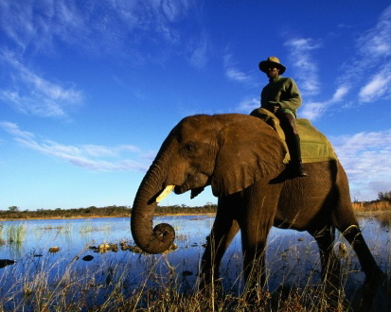
Switch
DIRECT the Rider
MOTIVATE the Elephant
SHAPE the Path
Notes:
The Rider – The Rational mind
The Elephant – The Emotional mind
The Path – The Environment
The Rational mind wants to change something at work; The Emotional mind loves the comfort of the existing routine.
To achieve change, both minds will have to be united.

Slide 64
Switch:
How to Change Things When Change is Hard
Direct the RIDER | Motivate the ELEPHANT | Shape the PATH
Follow the Bright Spots | Find the Feeling | Tweak the Environment
Script the Critical Moves | Shrink the Change | Build Habits
Point to the Destination | Grow Your People | Rally the Herd

Slide 65
Switch:
How to Change Things When Change is Hard
Direct the RIDER | Motivate the ELEPHANT | Shape the PATH
Follow the Bright Spots Find what is working well and reproduce | Find the Feeling Appeal to the emotions | Tweak the Environment Modify the environment to make the change “easy”
Script the Critical Moves Give prescriptive direction needed to accomplish the change | Shrink the Change Make change stepwise, with achievable steps | Build Habits Help the change to become “automatic”
Point to the Destination Give the “big picture”, describe the future state | Grow Your People Invest in your people – education, encouragement | Rally the Herd Engage the whole team & all stakeholders
Notes:
While all of these elements are important, time constraints will force us to select a few that we will focus on in this course. At the beginning of the project, the focus will be on Motivating the Elephant: Finding the feeling. Other of the elements will be addressed, especially as we talk about methodologies in the Improve phase.

Slide 66

Motivate the Elephant: Find the Feeling
The Glove Shrine
http://heathbrothers.com/member-content/switch-for-organizations-the-workbook/
Notes:
Say, “Finding the Feeling is where your change efforts will begin”. Share the story of the “glove shrine” from Switch. Move to the activity slide.
In their book Switch, authors Dan and Chip Heath talk about how to build support for and change existing situations. They cited one situation involving a traveling glove display that has practical applications for instigating any needed changes.
Here’s how it works.
A Purchasing manager wanted to show the consequences of not having a standardized purchasing policy for stock items like gloves, and how it could save their company $1 billion over five years. So he sent an intern around to gather samples of each of the 424 different types of work gloves the company was purchasing.
The Purchasing Manager then labeled the samples with the price paid for each glove, stacked them on a conference room table, and invited the executives in to literally see what their lack of a centralized purchasing policy was costing.
The effect was stunning and visceral. In some cases, the same gloves were being sold by different vendors at different prices. In others, glove quality was lower than needed while in others they were overbuying and paying too much. The executives who saw it had a visceral reaction, which was: this is crazy and has to change. And the traveling glove display helped provide the mandate for the change the Purchasing manager was looking for. (note: for the full story, read Switch).

Slide 67
ACTIVITY
Motivate the Elephant: Find the Feeling
  Can you make the need for change visual?
  The camera crew thought experiment.
  The pivotal testimonial.
  Build your own shrine.
What you will need:
Change Management Plan
Problem Statement
Flip Chart Page
Marker
20 MIN
http://heathbrothers.com/member-content/switch-for-organizations-the-workbook/
Notes:
Give groups time to engage in the Camera Crew Experiment, determine the “who” for the pivotal testimonial and “what” they might do to “build their own shrine”. Complete the Change Management Plan.

Slide 68
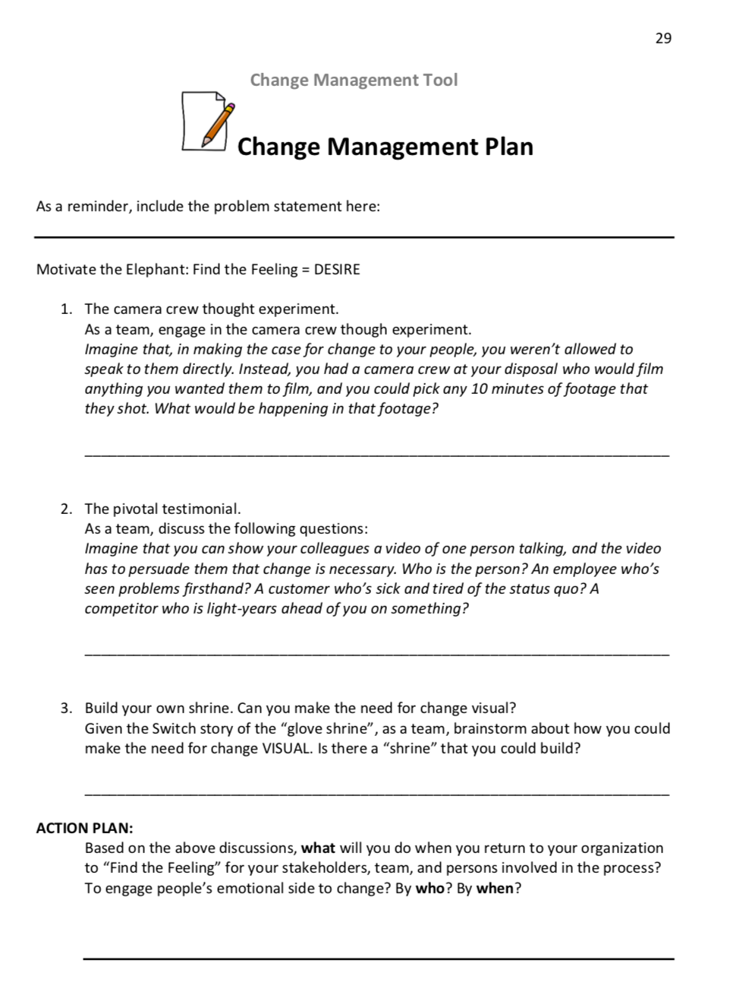
Workbook, p. 29

Slide 69
ACTIVITY
Motivate the Elephant: Find the Feeling
  Can you make the need for change visual?
  The camera crew thought experiment.
  The pivotal testimonial.
  Build your own shrine.
Share your action plans
What you will need:
Change Management Plan
Problem Statement
Flip Chart Page
Marker
Debrief:
20 MIN
http://heathbrothers.com/member-content/switch-for-organizations-the-workbook/
Notes:
Give groups time to engage in the Camera Crew Experiment, determine the “who” for the pivotal testimonial and “what” they might do to “build their own shrine”. Complete the Change Management Plan.

Slide 70
Switch:
How to Change Things When Change is Hard
Direct the RIDER | Motivate the ELEPHANT | Shape the PATH
Follow the Bright Spots Find what is working well and reproduce | Find the Feeling Appeal to the emotions | Tweak the Environment Modify the environment to make the change “easy”
Script the Critical Moves Give prescriptive direction needed to accomplish the change | Shrink the Change Make change stepwise, with achievable steps | Build Habits Help the change to become “automatic”
Point to the Destination Give the “big picture”, describe the future state | Grow Your People Invest in your people – education, encouragement | Rally the Herd Engage the whole team & all stakeholders
Notes:
While all of these elements are important, time constraints will force us to select a few that we will focus on in this course. At the beginning of the project, the focus will be on Motivating the Elephant: Finding the feeling. Other of the elements will be addressed, especially as we talk about methodologies in the Improve phase.

Slide 71
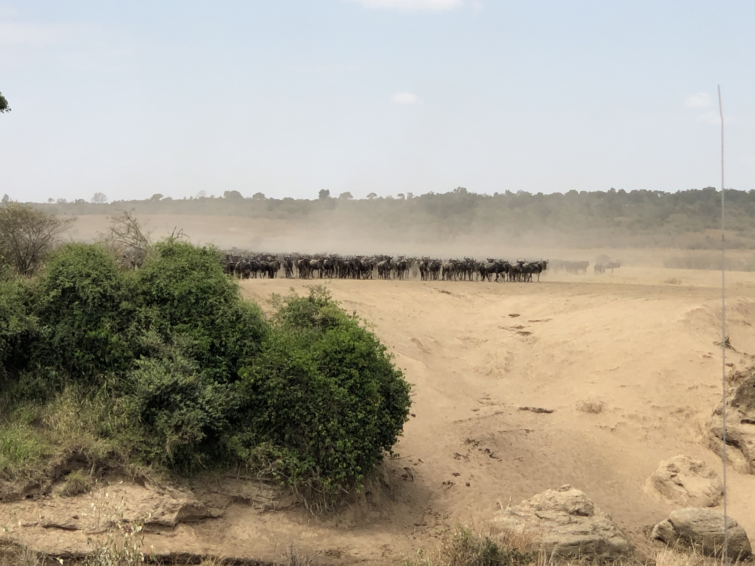
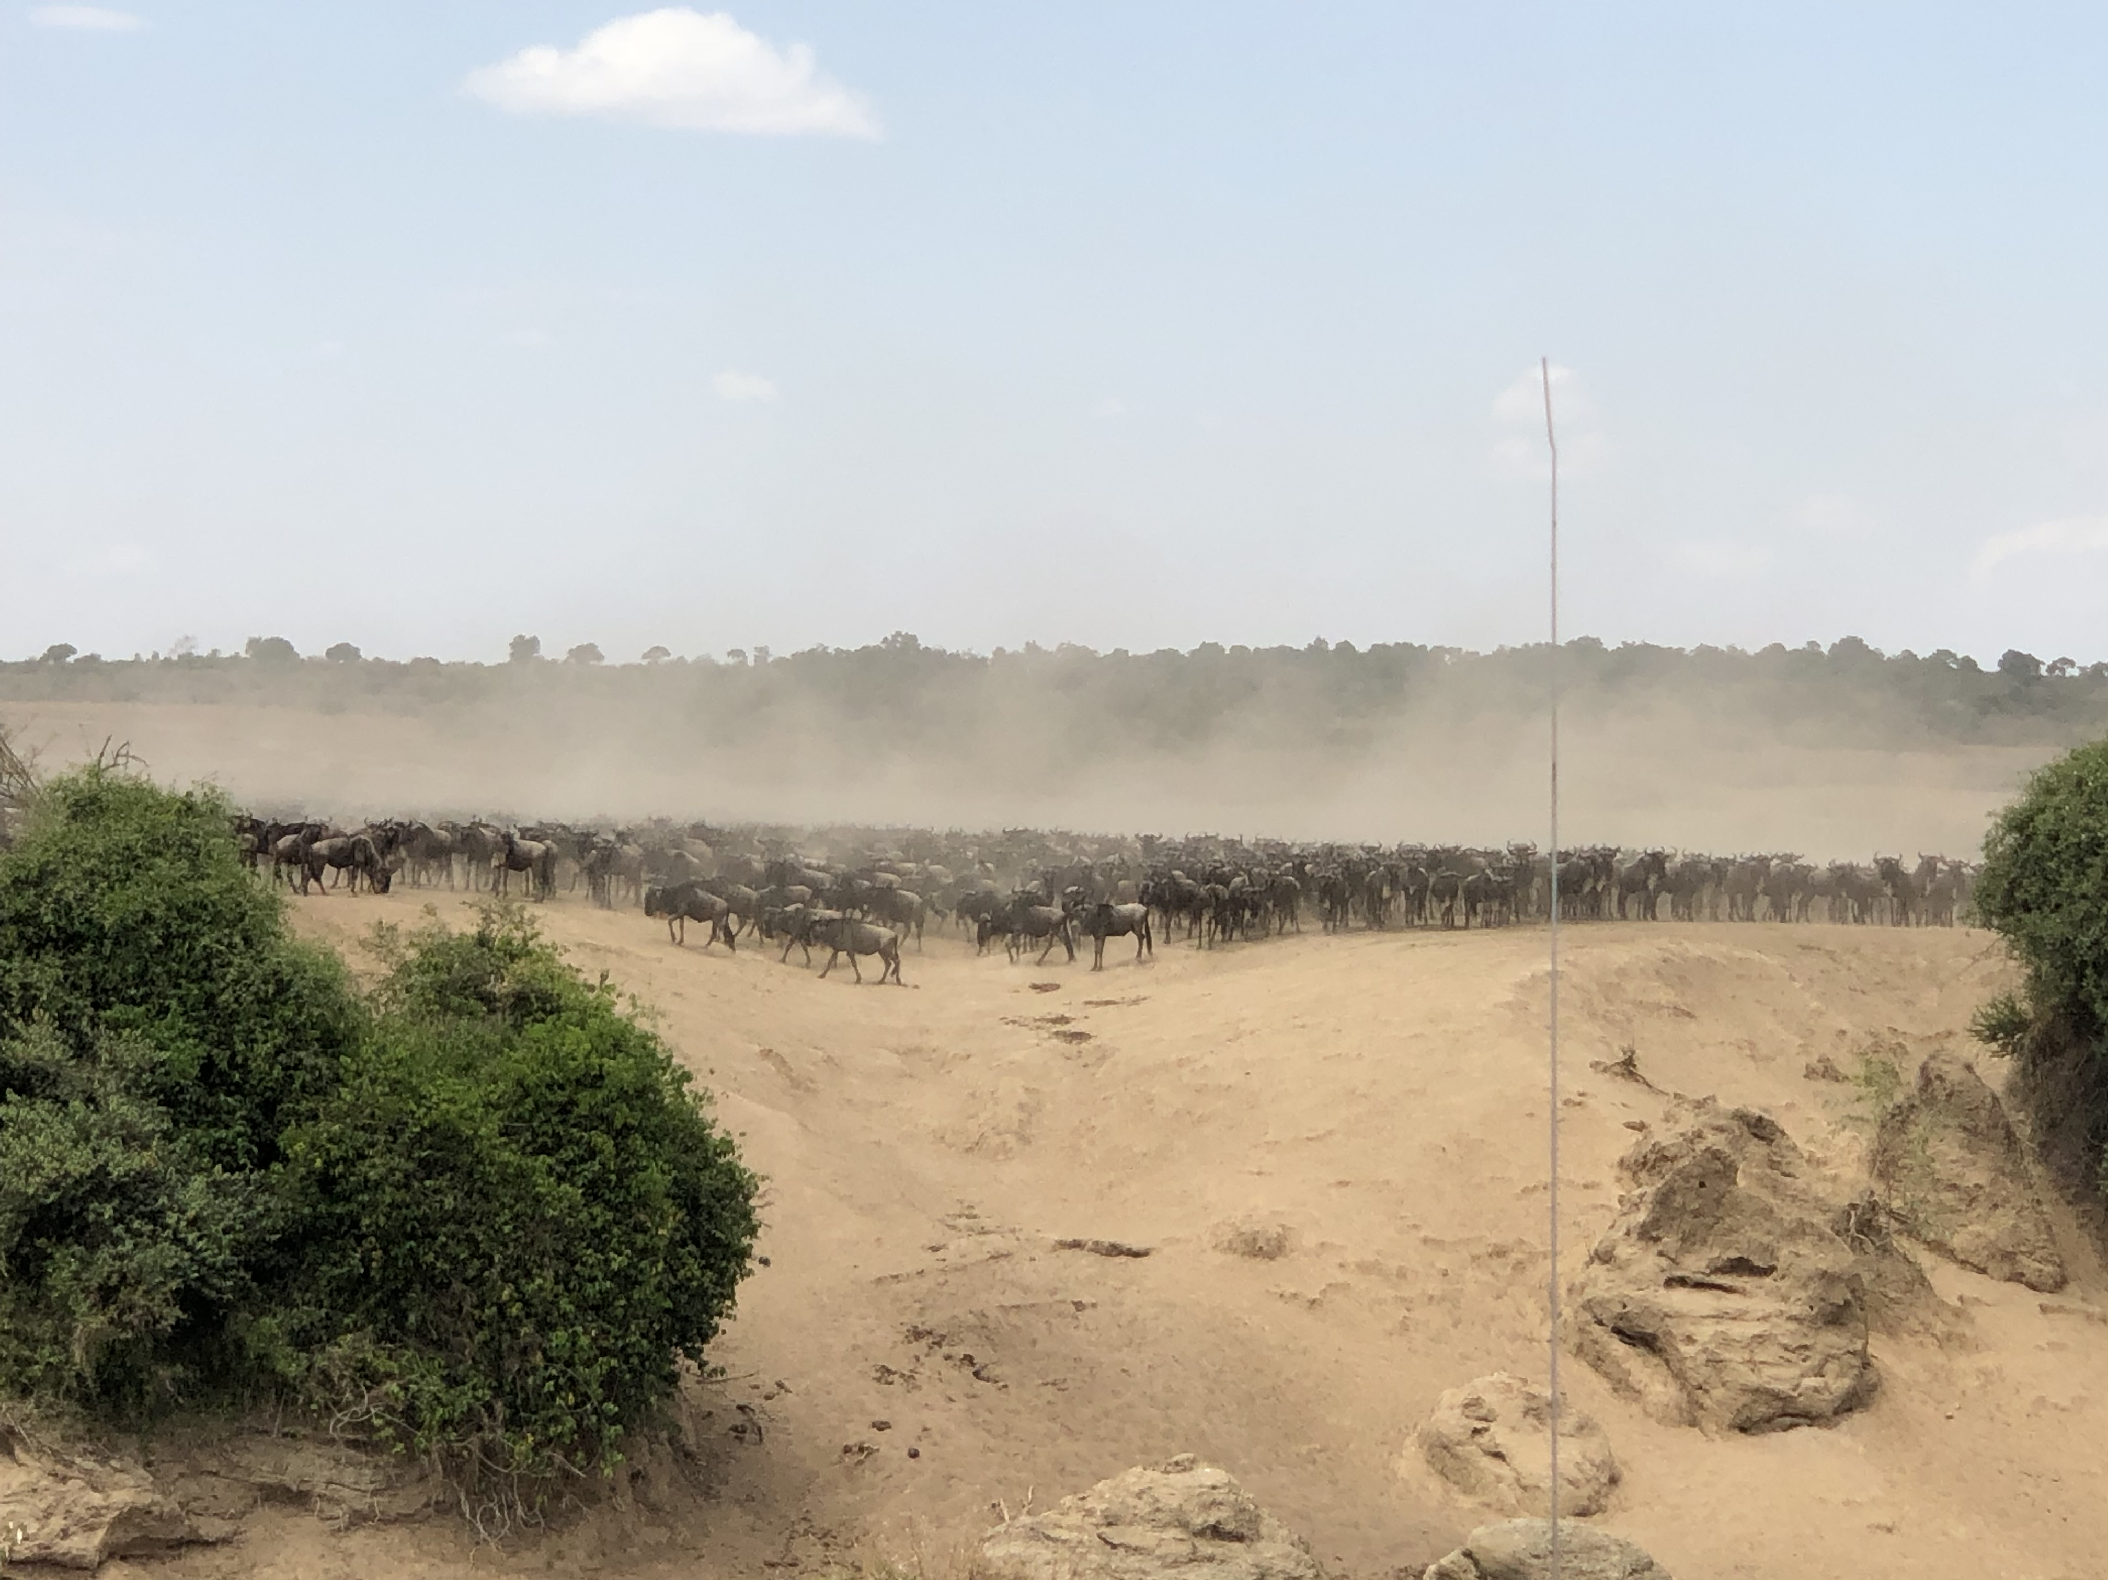
Shape the Path: Rally the Herd

Slide 72


Slide 73
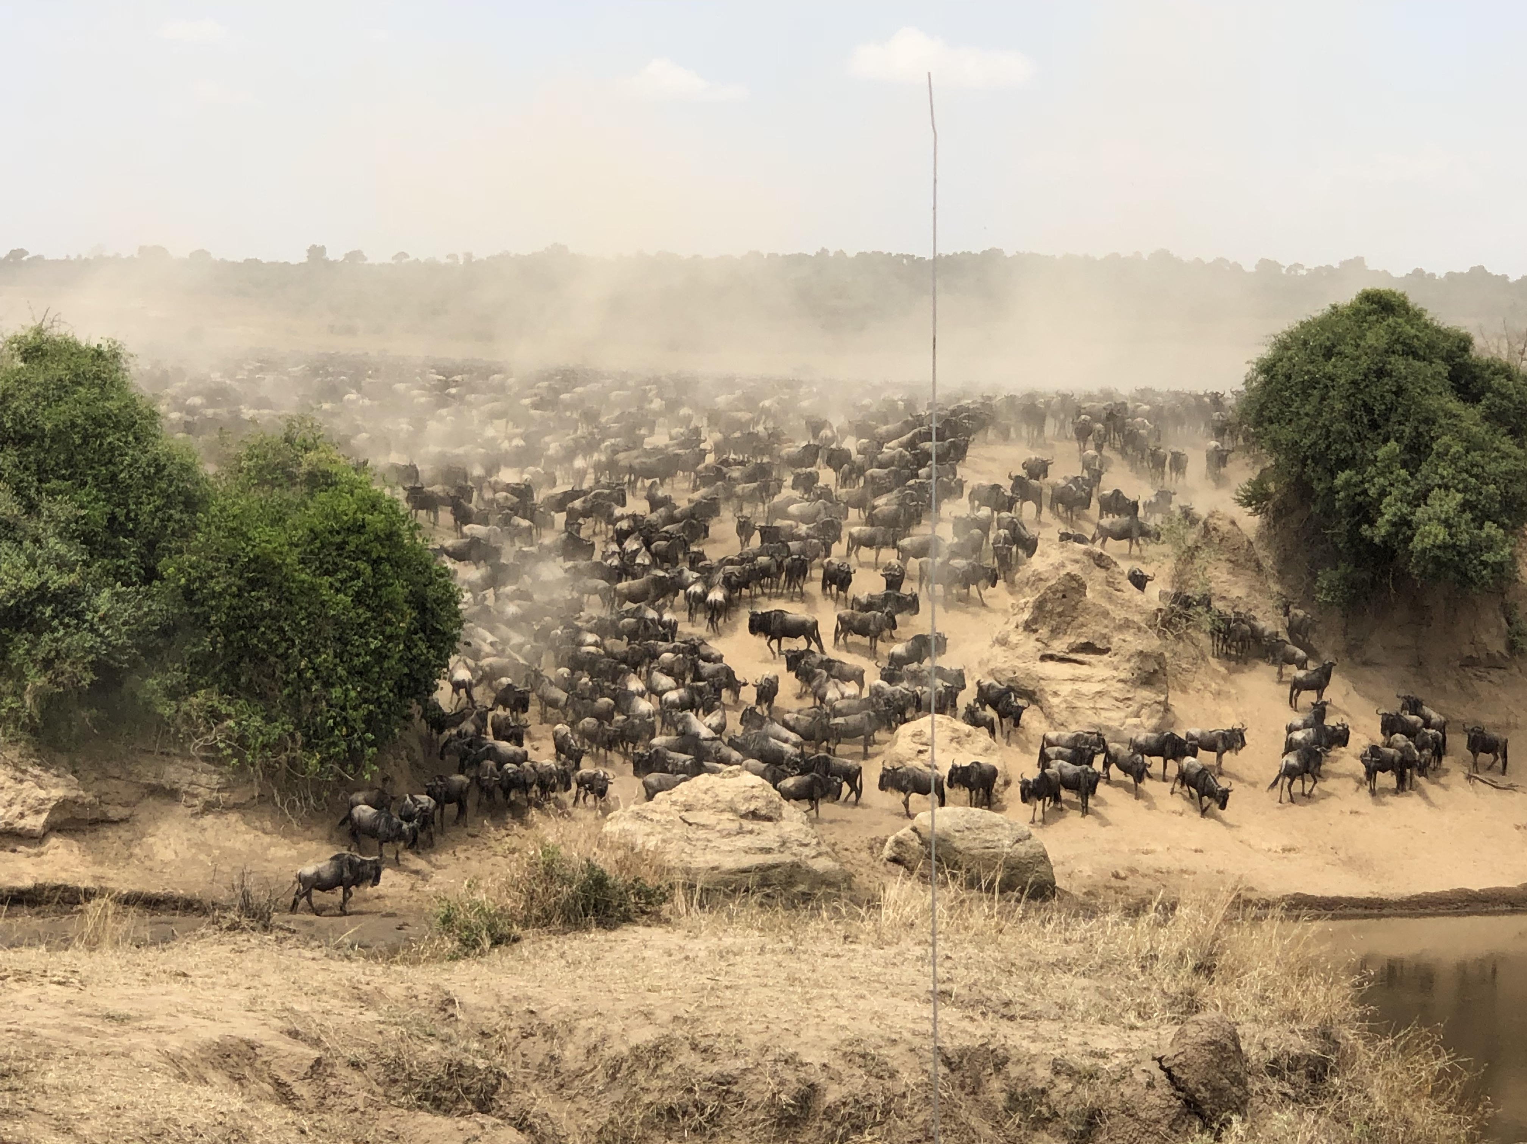
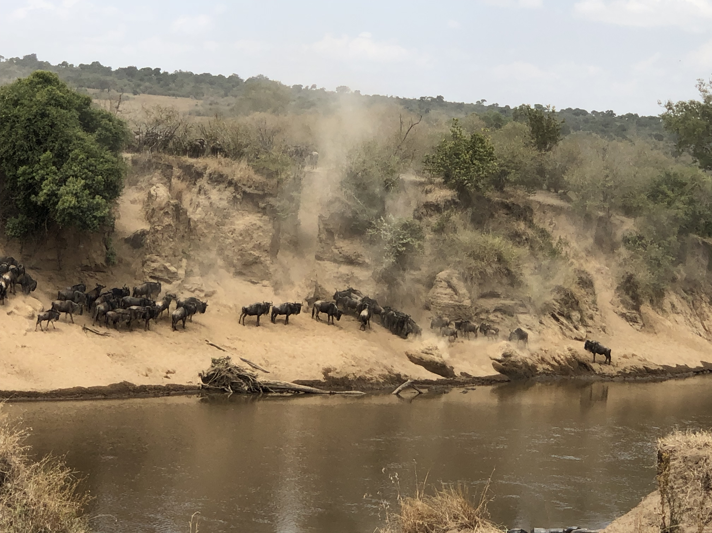
Shape the Path: Rally the Herd

Slide 74
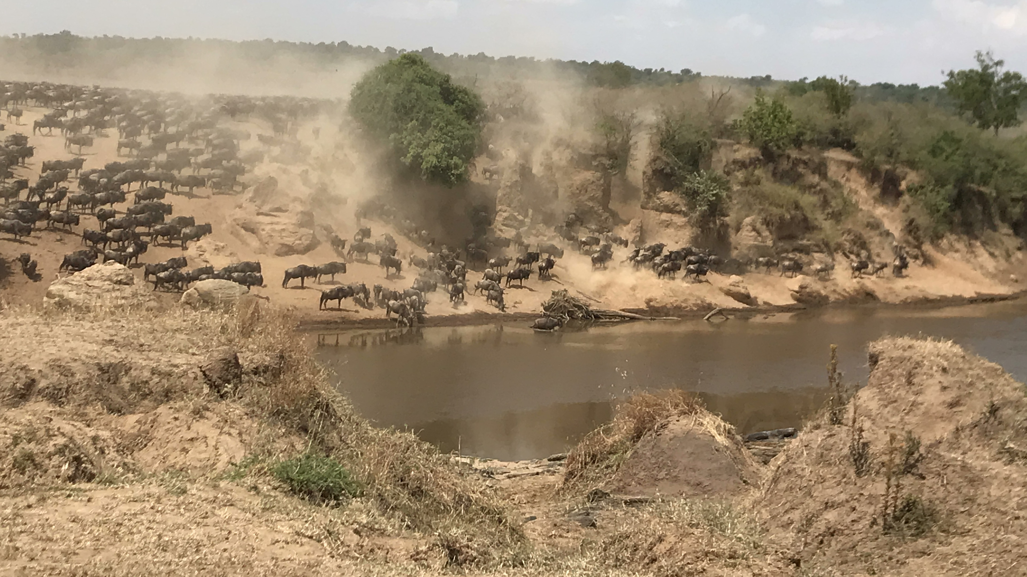
Shape the Path: Rally the Herd

Slide 75
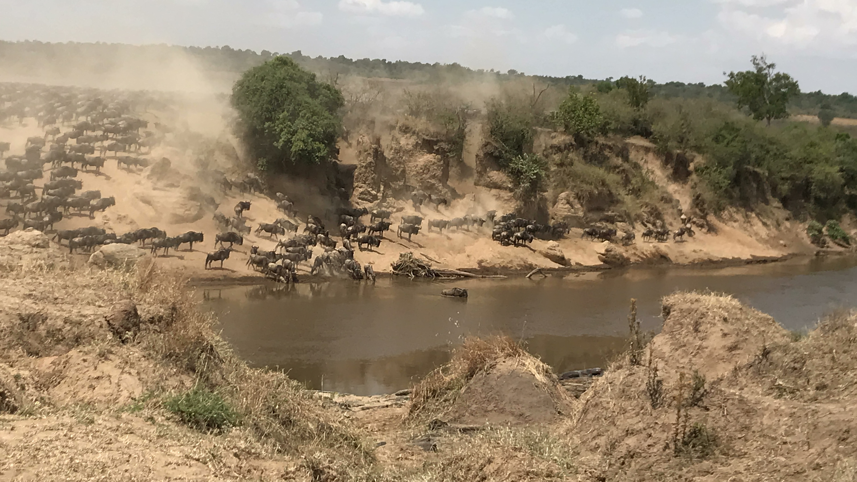
Shape the Path: Rally the Herd

Slide 76
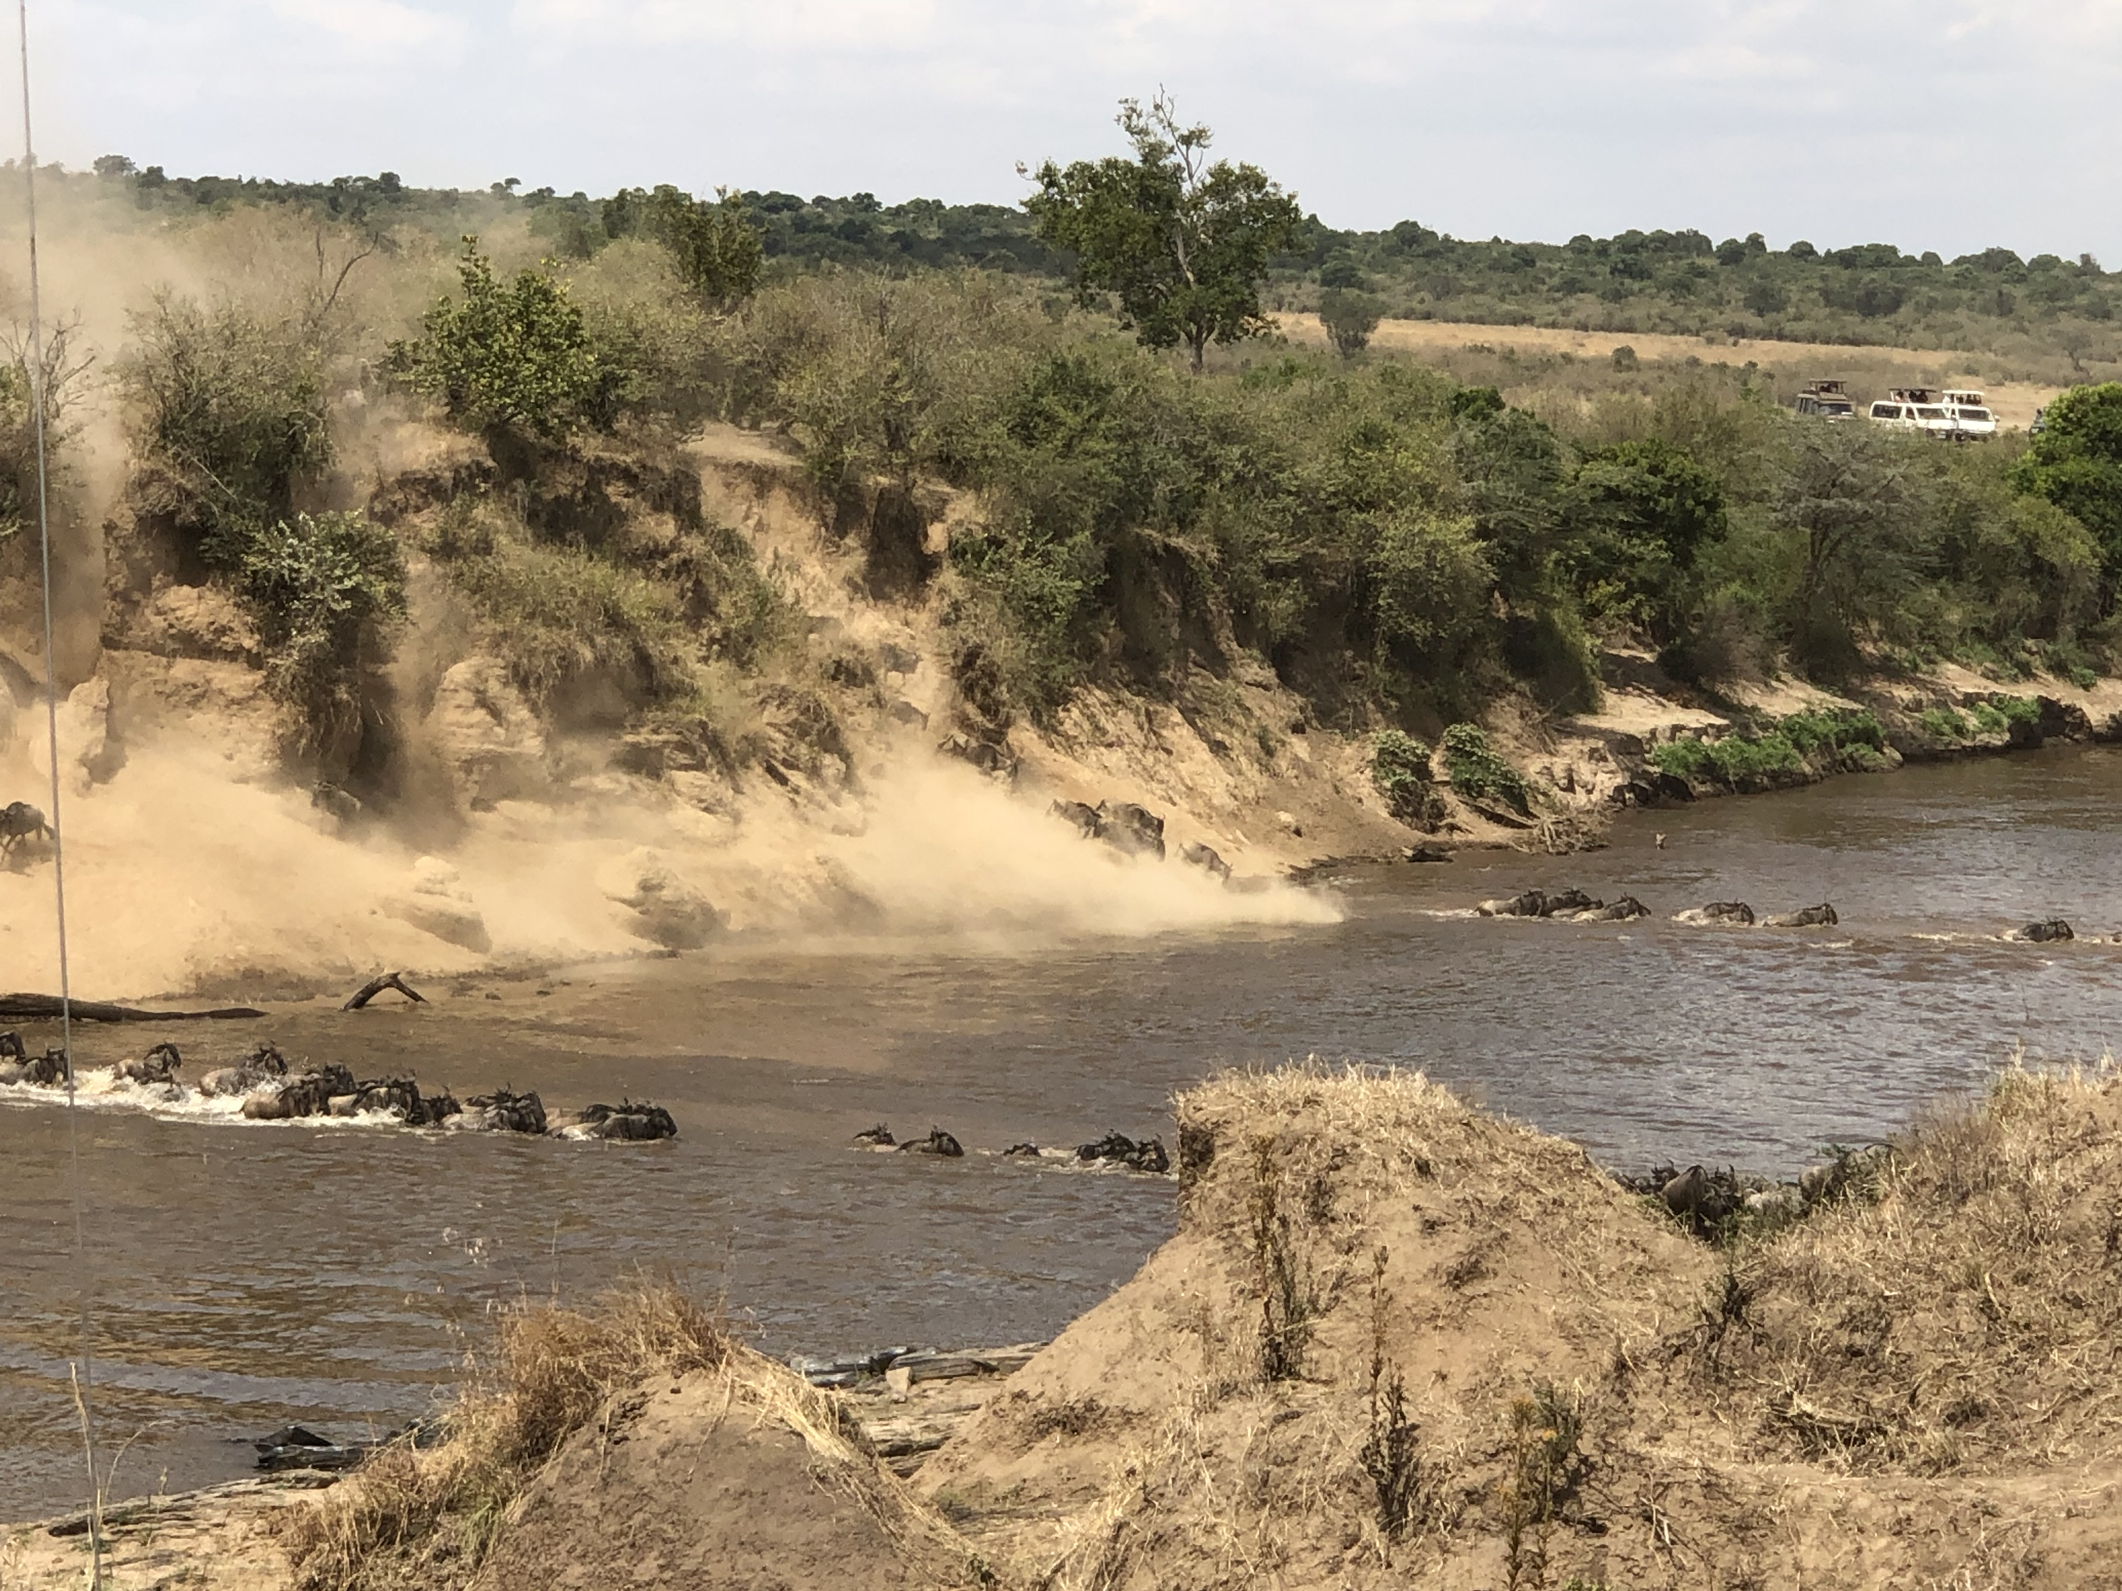
Shape the Path: Rally the Herd

Slide 77
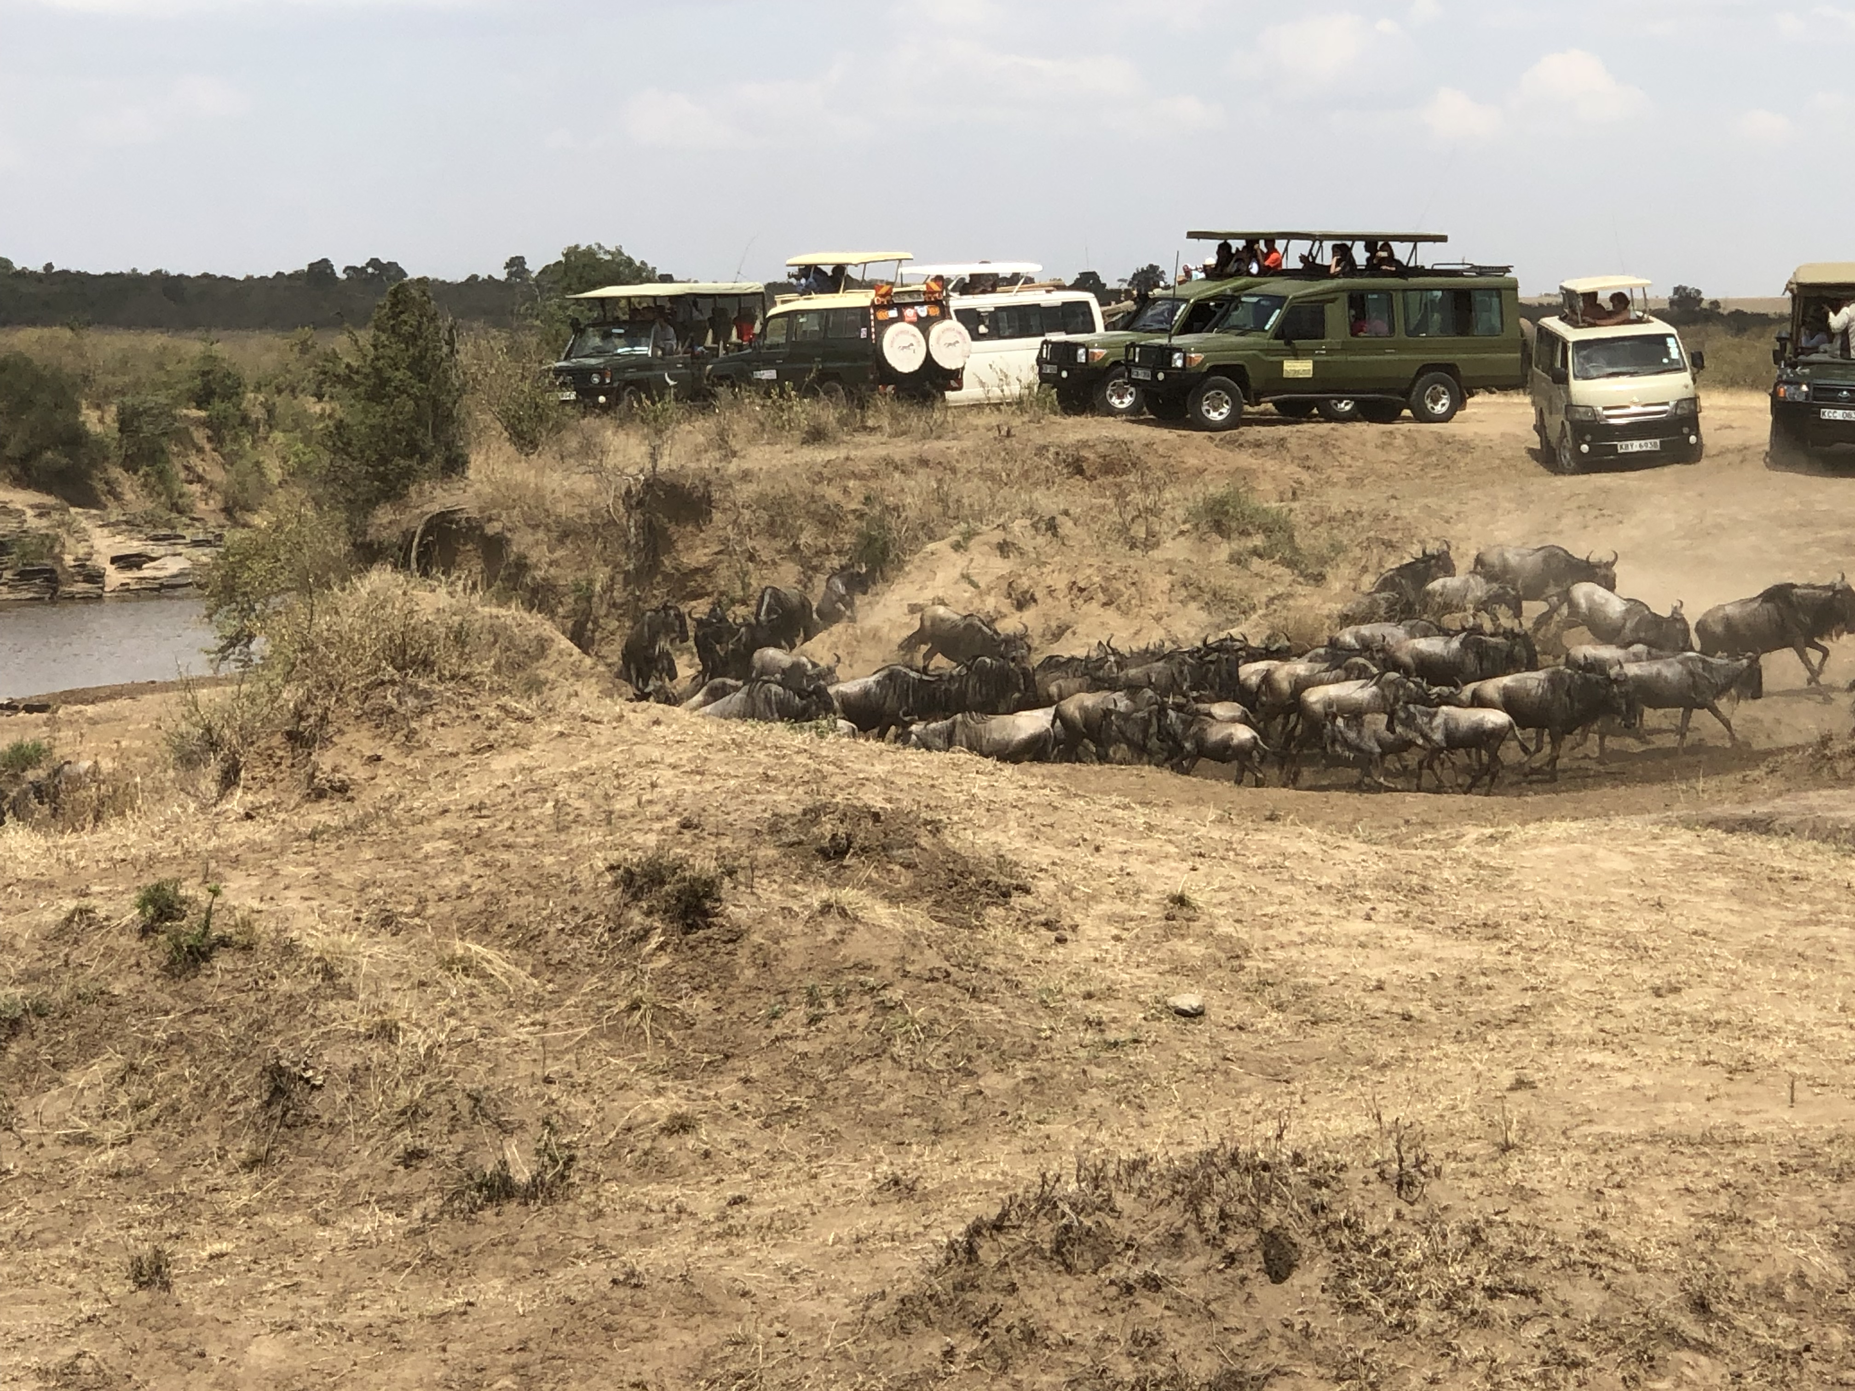
Shape the Path: Rally the Herd

Slide 78
Switch:
How to Change Things When Change is Hard
Direct the RIDER | Motivate the ELEPHANT | Shape the PATH
Follow the Bright Spots | Find the Feeling | Tweak the Environment
Script the Critical Moves | Shrink the Change | Build Habits
Point to the Destination | Grow Your People | Rally the Herd

Slide 79
Direct the Rider: Script the Critical Moves
Be clear about how people should act.
Pick one place to start.
For a change effort to work, leaders have to transform aspirations into actions.
Coming Attractions
Notes:
This idea will be revisited when we address the IMRPOVE phase, specifically standardized work & PDSA.

Slide 80



Shape the Path: Tweak the Environment
Notes:
Introduce the concept - Change must be made as easy as possible. Share the story of the Staples ”Easy” button and Amazon “1-Click” – marketing master pieces that make buying easy, eliminating extra steps.

Slide 81
Shape the Path:
Tweak the Environment
Do a “motion study”.
Emphasize “tweak.”
Do a 5-min rescue on your environment.
Can you run the McDonalds playbook?
Can you 1-Click your process?
Coming Attractions
Notes:
We will spend more time on these concepts in the IMPROVE section, when we talk about improvement methodologies such as Lean, 5S, spaghetti diagrams and future state maps.

Slide 82
Shape the Path: Build Habits
Set an action trigger.
Create a checklist.
Coming Attractions
Notes:
Will be revisited in the IMPROVE section – Standardized work.

Slide 83
Switch
DIRECT the Rider
MOTIVATE the Elephant
SHAPE the Path

Slide 84
Deliverables
Change Management Plan
Related Tools:
  Stakeholder Analysis
  Communication Plan
Workbook, p. 27-29

Slide 85
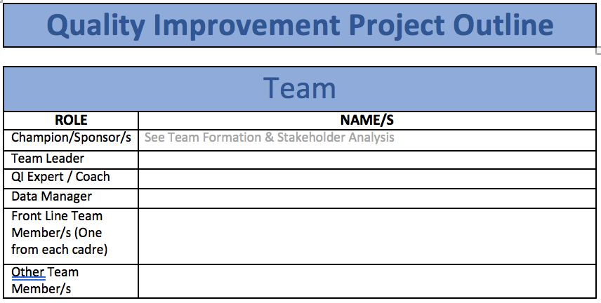
Team Formation
Workbook, p. 30-32

Slide 86
Team Functional Assessment
IHI QI 201: Planning for Spread
Novice Team
Meets weekly; manager and director are engaged and present
Has begun small tests of change with PDSA documentation
Working on building a team and seeing failure in a positive light
Strong Team
Has implemented more than three successful initiatives in the unit
Is submitting measures
Advanced Team
Has met or exceeded project performance targets
Mentors other teams

Slide 87
The LARC Quality Improvement Collaborative:
Learning Session I
How to be a Quality Ninja
DEFINE
LARC

Slide 89
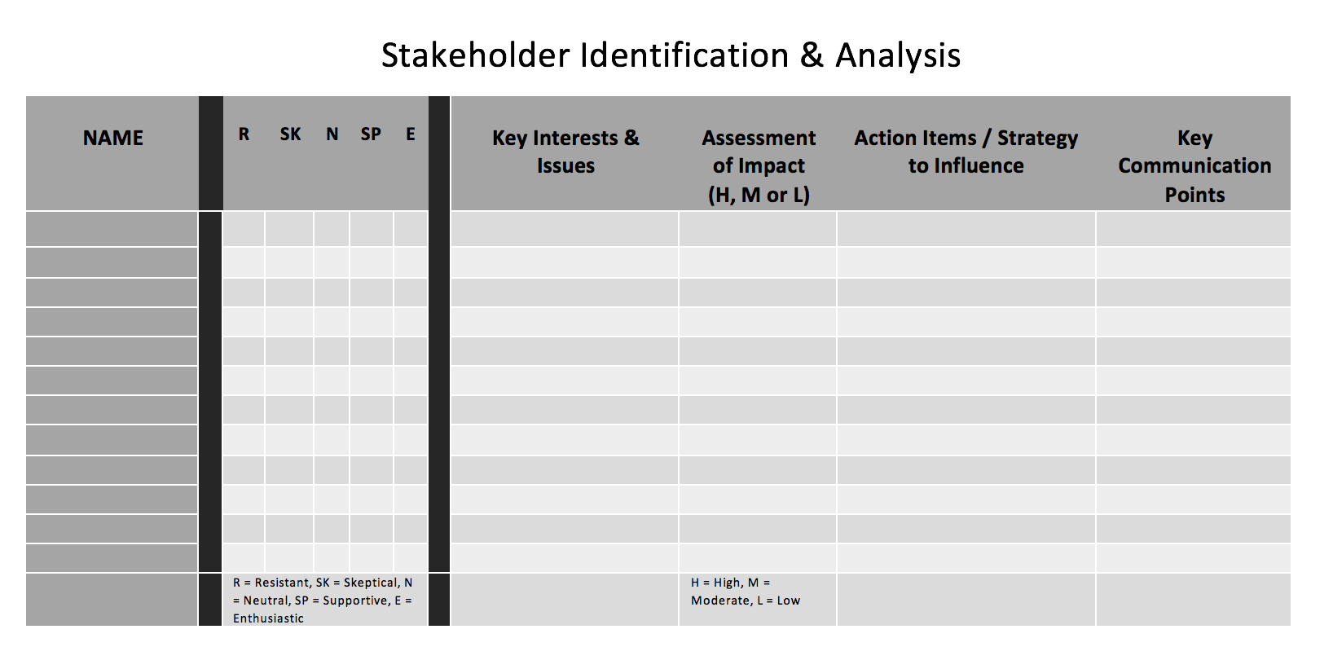
Stakeholder Analysis
Workbook, p. 34-37

Slide 90
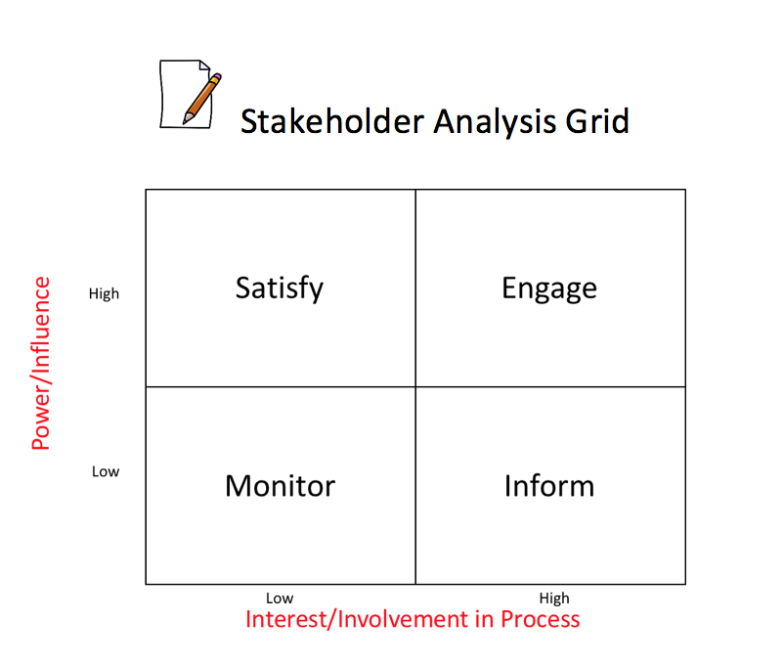
Stakeholder Analysis Grid
Workbook, p. 34-37

Slide 91
ACTIVITY
Stakeholder Identification / Analysis
  Identify Stakeholders
  Using one of the 2 tools, analyze your stakeholders
  Indicate the subsequent communication and action plans
  Update the plans
What you will need:
Stakeholder Identification & Analysis AND/OR Stakeholder Analysis Grid
Workbook, p. 34-37
10 MIN

Slide 92
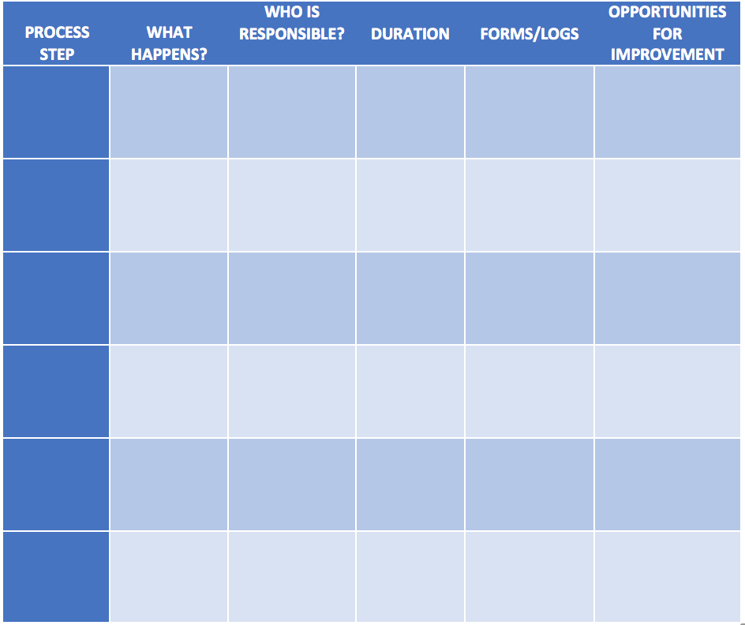
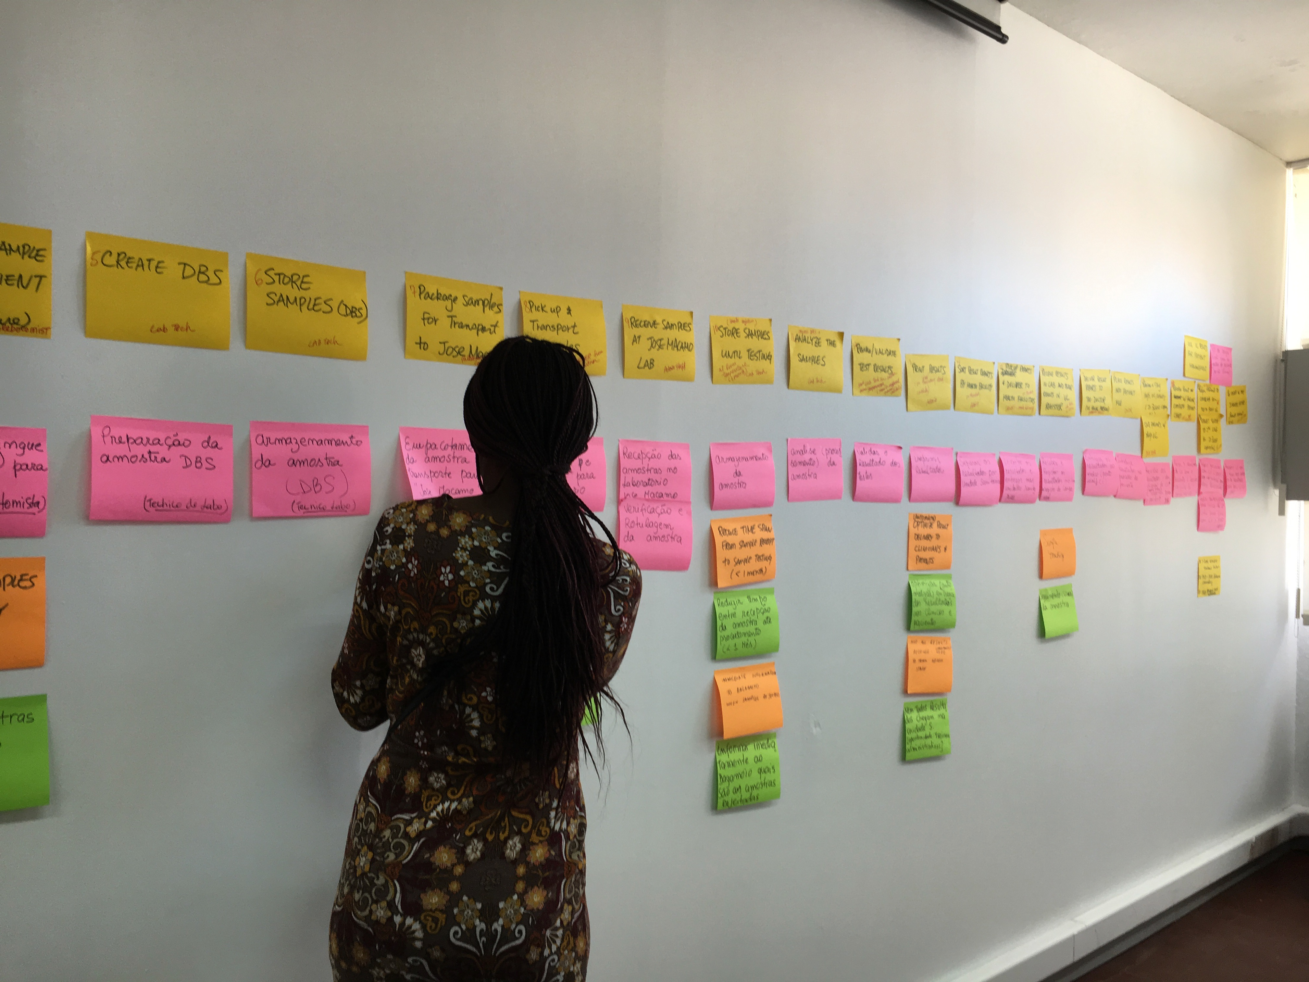
Process Mapping
Workbook, p. 38-41

Slide 93
Guiding Principles for Quality Improvement
Focus on the needs of the USERS
Focus on PROCESSES to increase the productivity of work
Use DATA to improve services
Use TEAMS to improve quality
Improve COMMUNICATION

Slide 94
Guiding Principles for Quality Improvement
Focus on the needs of the USERS
Focus on PROCESSES to increase the productivity of work
Use DATA to improve services
Use TEAMS to improve quality
Improve COMMUNICATION

Slide 95
Process = A series of actions or steps taken in order to achieve a particular end

Slide 96
Process = Sequence of procedures to convert inputs into outputs
INPUTS
Input #1
Input #2
Input #3
Process Step
A
Process Step
B
OUTPUT
Process Step
C

Slide 97


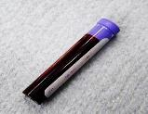
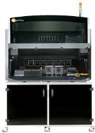

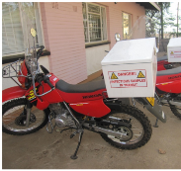
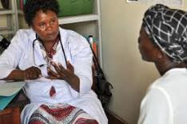
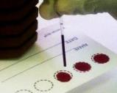

The Viral Load Cascade
Demand Creation for Testing
Specimen Collection & Processing
Sample Transport
Laboratory Testing
Result Reporting & Interpretation by Clinician
Patient Management

Slide 98
"Draw a flowchart (process map) for whatever you are doing. Until you do, you do not fully understand what you are doing. You just have a job.”
                W Edwards Deming (1900-1993)

Slide 99
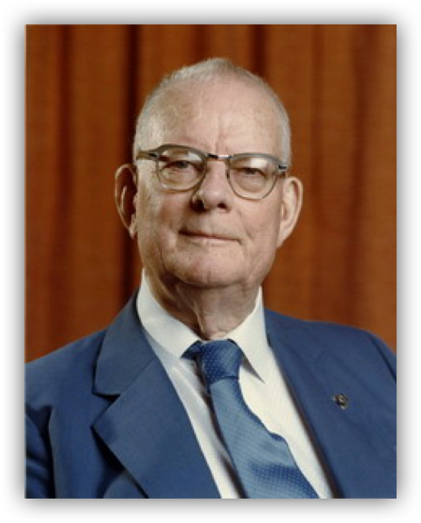
"The first step in any organization is to draw a flow diagram (process map) to show how each component depends on others. Then everyone may understand what their job is. If people do not see the process, they cannot improve it."
                W Edwards Deming (1900-1993)

Slide 100
Why are processes important?
INTERDEPENDANCE
SEE
See how components depend on each other
Understand/See Process
IMPROVE
Improve Process
The way we do our work

Slide 101
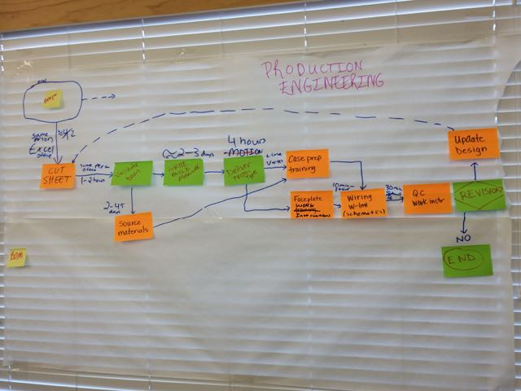

Slide 102
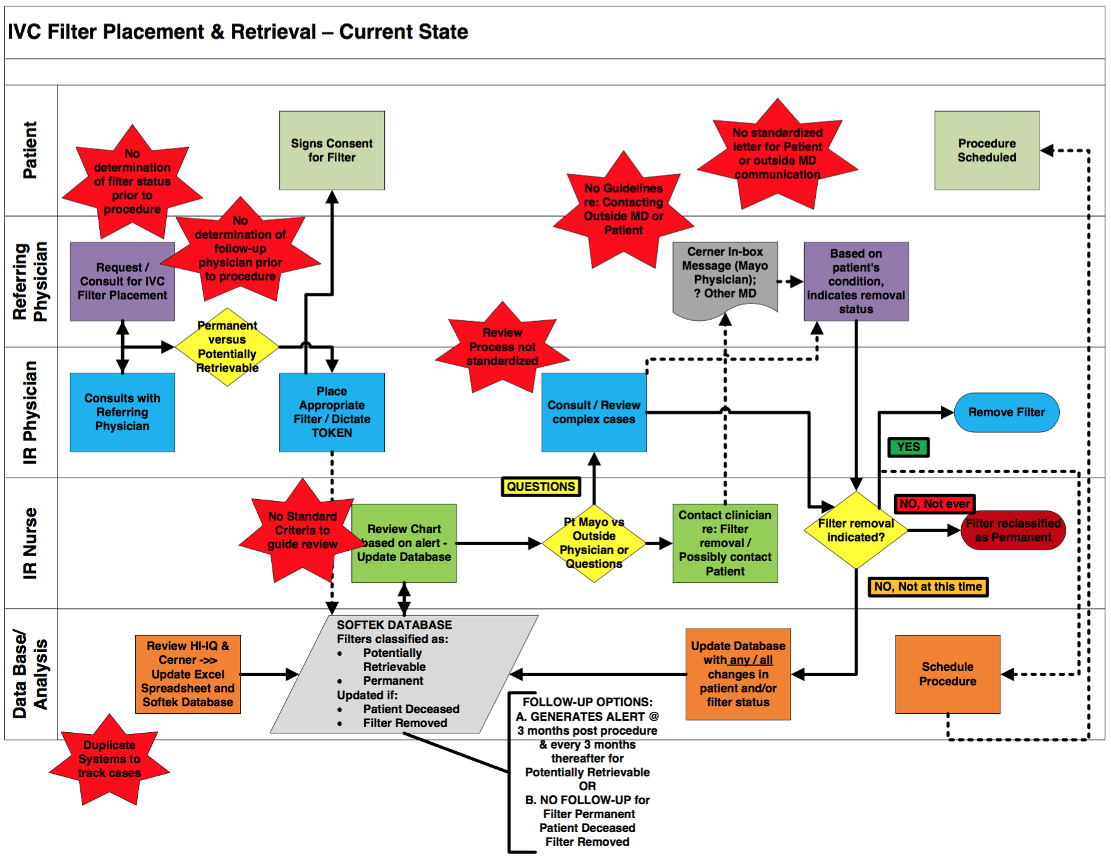
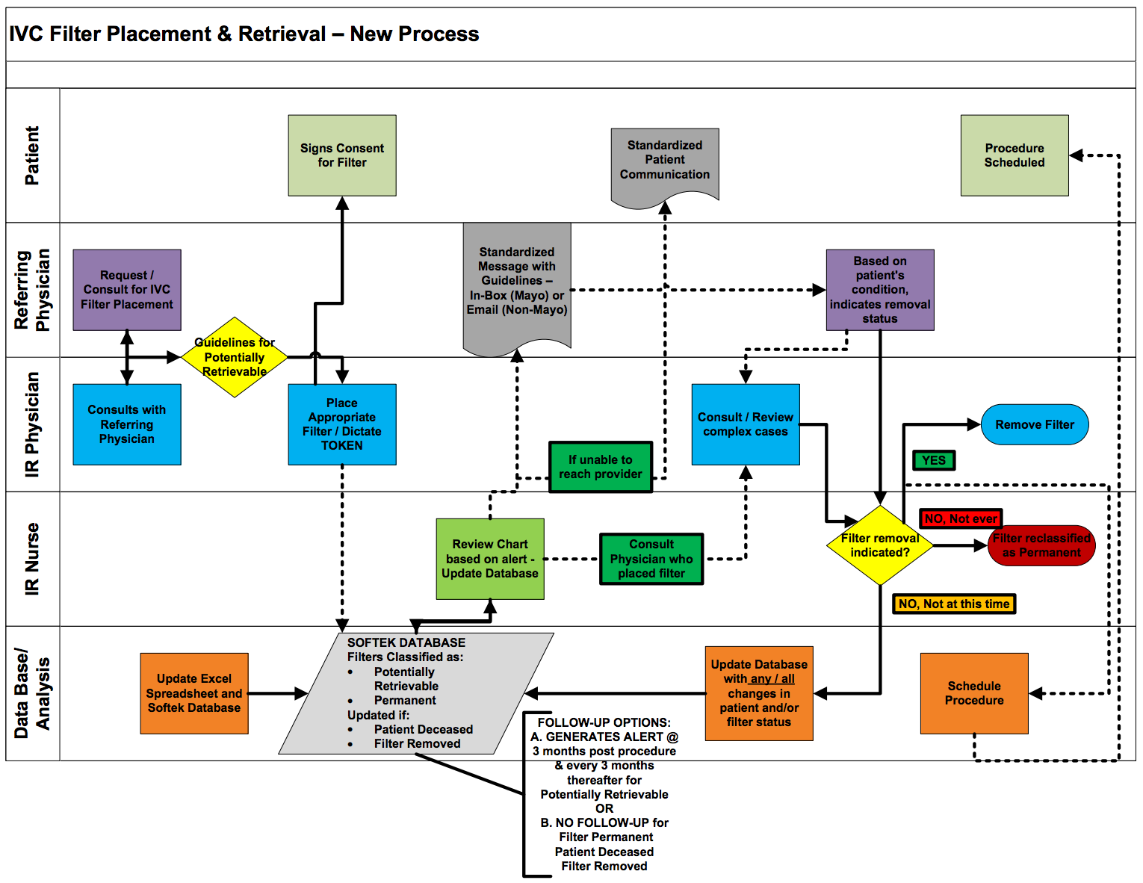
Process Maps
Current State
Future State

Slide 103
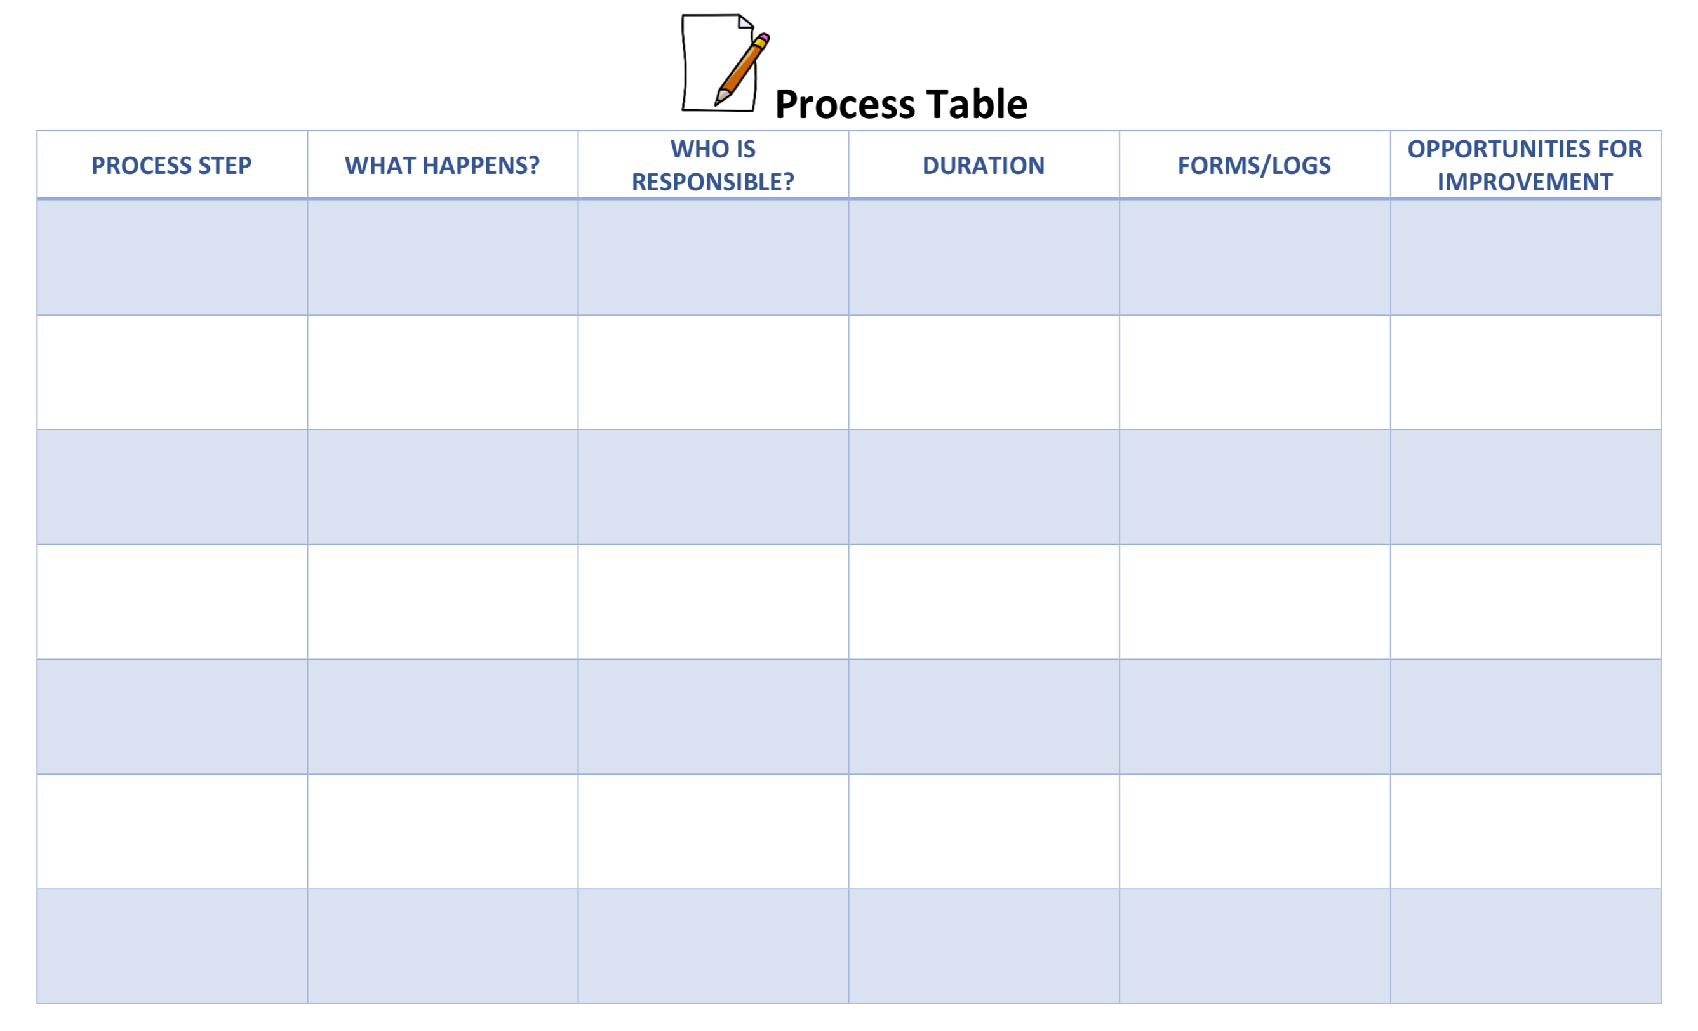

Slide 104
Benefits of Process Mapping
Based on your Smart Start Process Mapping activity, share the benefits for your team.

Slide 105
P + S = O
Process
Structure

Slide 106
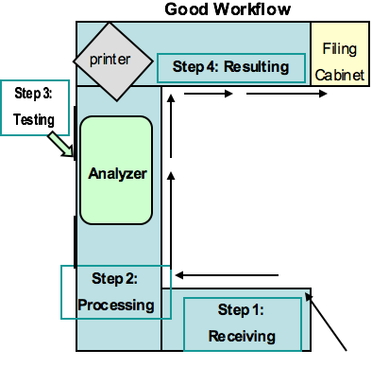
Structure
Physical Structure
Organization / Culture

Slide 107
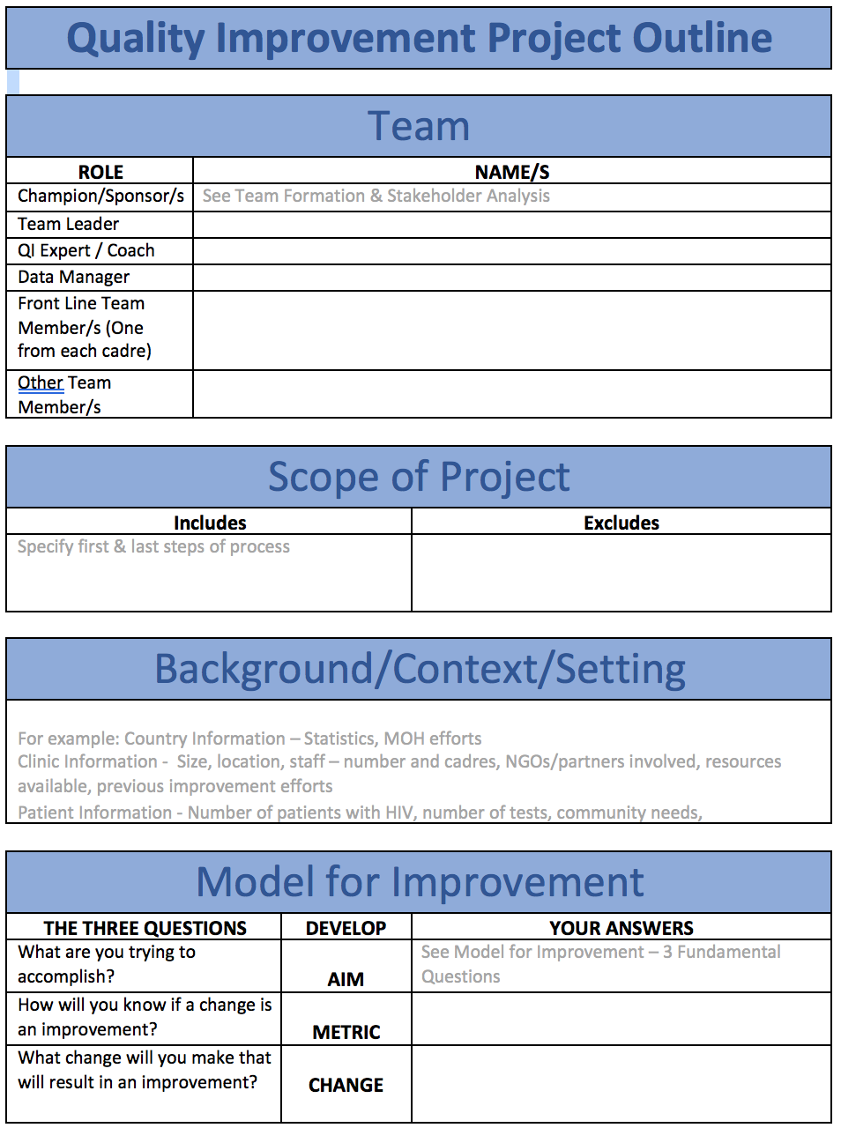
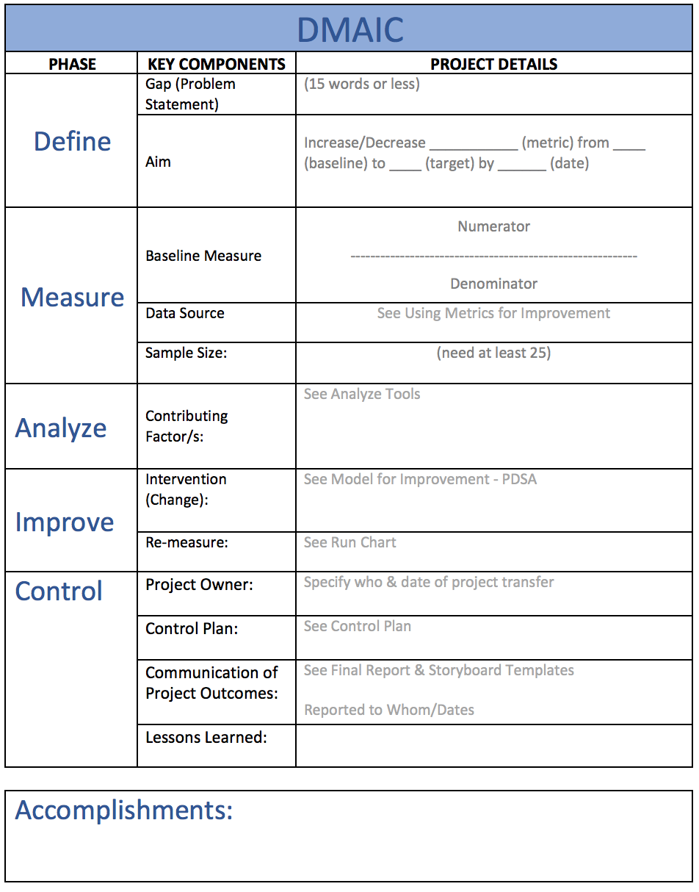
Workbook, p. 13 & 14

Slide 108
Guiding Principles for Quality Improvement
Focus on the needs of the USERS
Focus on PROCESSES to increase the productivity of work
Use DATA to improve services
Use TEAMS to improve quality
Improve COMMUNICATION

Slide 109
Guiding Principles for Quality Improvement
Focus on the needs of the USERS
Focus on PROCESSES to increase the productivity of work
Use DATA to improve services
Use TEAMS to improve quality
Improve COMMUNICATION

Slide 110
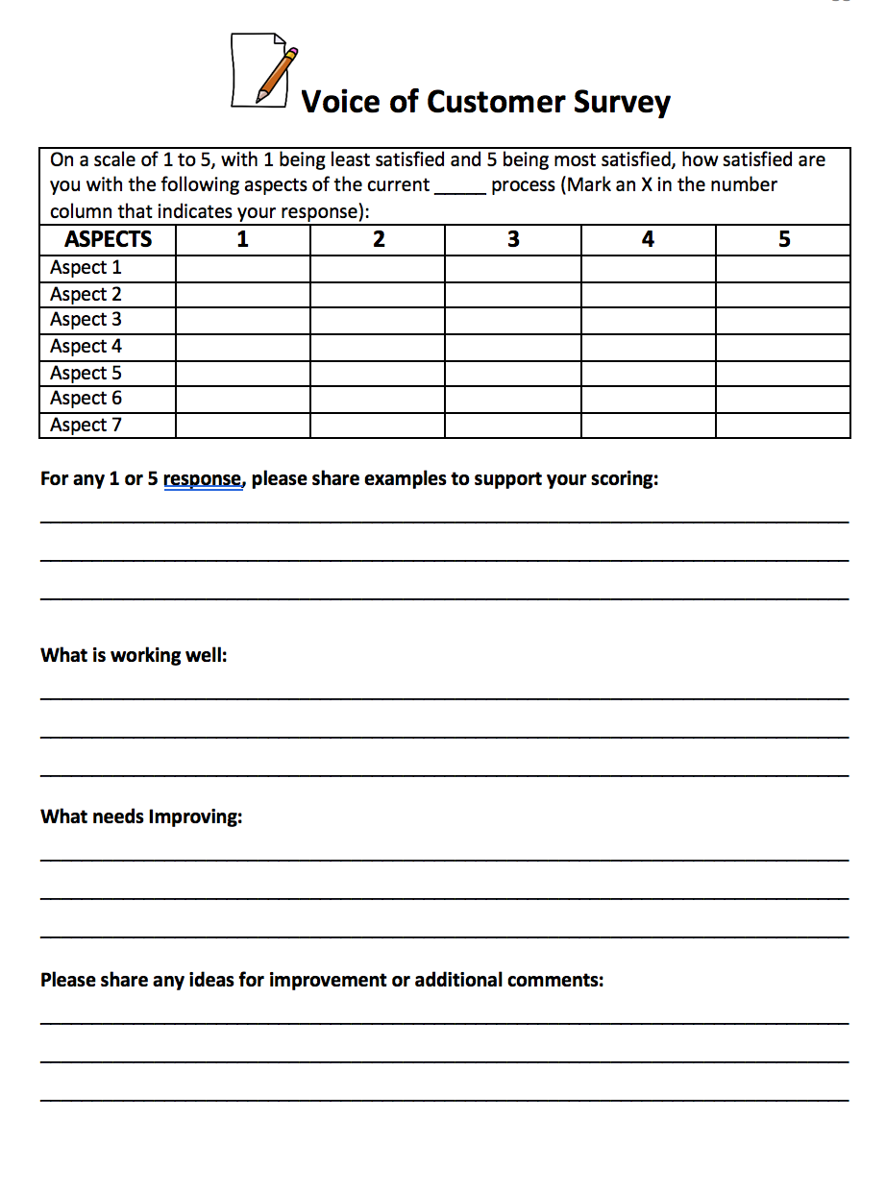
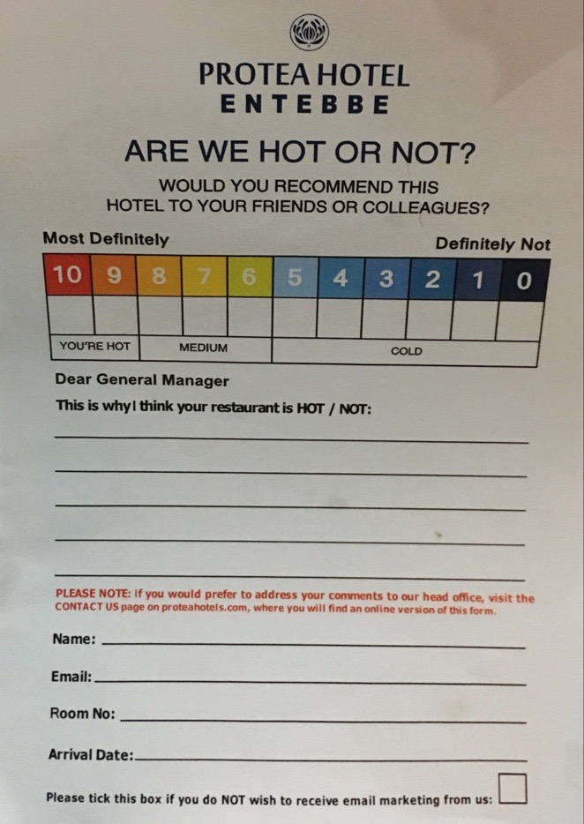
Voice of the Customer
Workbook, p. 43-45

Slide 111
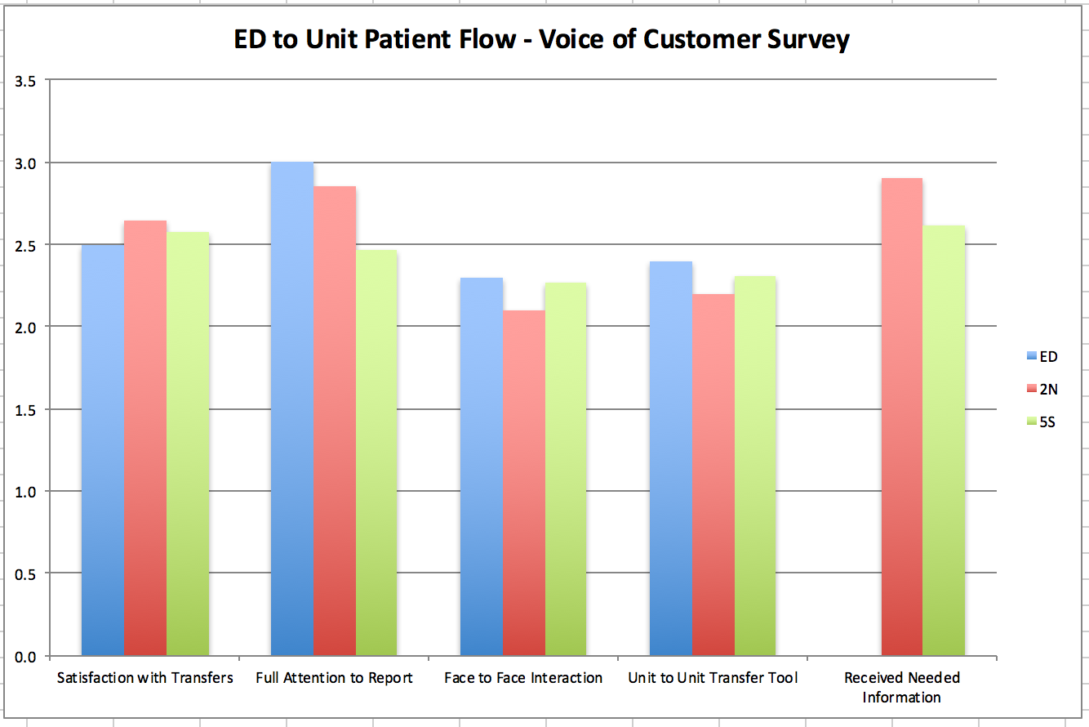
Voice of the Customer

Slide 112
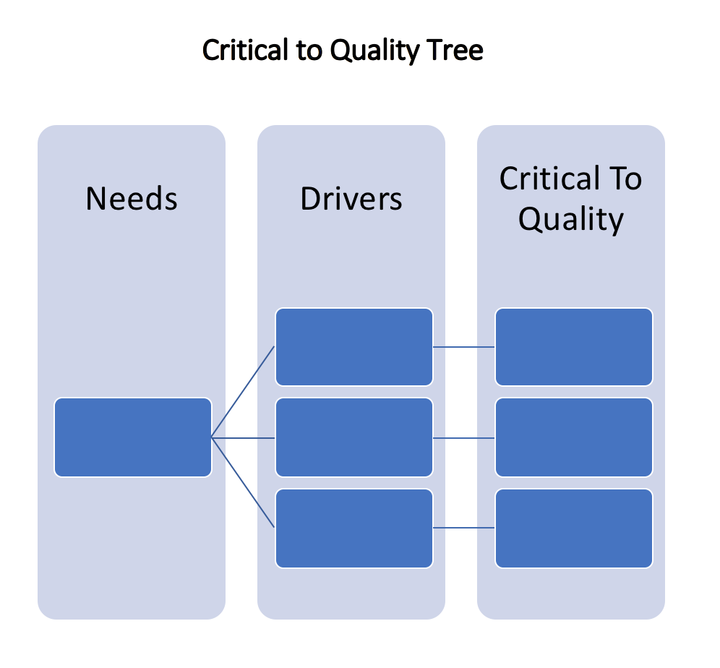
Critical to Quality
Workbook, p. 46

Slide 113
Critical To Quality (CTQ) Tree
Critical to Quality Example
Need
Drivers
CTQs
Answers given by reps are correct
Knowledgeable
reps
Reps can answer questions asked without further research
Researched info returned quickly
Good customer
service
Customers greeted by name
Friendly reps
Customers not interrupted
Customers asked if they need
anything else at the end of the call
Short waiting
time
Fast time to live person
Fast time from live person to answer
General
Specific
Hard to measure
Easy to measure
Notes:
113
A Critical to Quality Tree is a tool used to translate a general statement about “what is quality” for this process in to specifics that can be measured.
Build this graphic one click at a time. Guide the group through this exercise.
What drives good customer services?
What’s critical to quality with knowledgeable reps?
We define from general to specific; from hard to measure to easier to measure; from personal perspective to measurable proof that we’re providing what’s critical to quality.
CTQ doesn’t always have to be a part of a DMAIC project. You don’t always need to build a CTQ tree if the need is specific and measurable and completely unambiguous. But if there’s any doubt about what is meant by quality in this process, then defining CTQ is important.

Slide 114
Elevator Speech
This project is about __________________________________________
As a result of these efforts, __________________________________________
It’s important because we are concerned about:
____________________
____________________
Success will be measured by showing improvement in:
____________________
____________________
What we need from you –
______________________________
Workbook, p. 47

Slide 115
The LARC Quality Improvement Collaborative:
Learning Session I
How to be a Quality Ninja
MEASURE
LARC

Slide 116
Guiding Principles for Quality Improvement
Focus on the needs of the USERS
Focus on PROCESSES to increase the productivity of work
Use DATA to improve services
Use TEAMS to improve quality
Improve COMMUNICATION
Workbook, p. 6

Slide 117
Guiding Principles for Quality Improvement
Focus on the needs of the USERS
Focus on PROCESSES to increase the productivity of work
Use DATA to improve services
Use TEAMS to improve quality
Improve COMMUNICATION

Slide 119
Using Metrics for Improvement
Metric Selection
Data Collection Tool/s
Data Collection Plan
Data Display
Workbook, p. 48-55

Slide 120
Deliverables
Metric - Selected & Defined
Data Collection Tool
Data Collection Plan
Data Display
Workbook, p. 48-55

Slide 121
Metrics – WHY?
Evidence-based, objective criteria for decision making
Evidence of actual improvement - Gauge of project success – “How will you know if a change is an improvement?”
Results - “What gets measured, gets fixed.”
Visual
  “Graphs tell a story.”
  “Outcomes & goals that are not made visual will fail.”

Slide 122
WHY Collect Data?
To establish a factual basis for making decisions
“I think the problem is…”
“The data indicates the problem is…”
vs
Data Driven Decisions
Opinion Drive decisions
vs
Notes:
122
Data is needed to focus improvement efforts
Objective data is needed to make sound judgments.
Data from time studies, equipment loading data, takt times, staffing requirements, process yields, and lot and kanban sizing information will lead to workflow configurations and process layouts that help optimize value streams.
Good data collection forms organize information into useful formats, serve as communication tools, and help trigger solid improvement efforts.

Slide 123
Ask 3 Questions – The Model for Improvement
AIM
What are you trying to accomplish?
METRIC
How will you know if a change is an improvement?
CHANGE
What change will you make that will result in an improvement?

Slide 124
“What gets measured, gets fixed.”
DATA

Slide 125
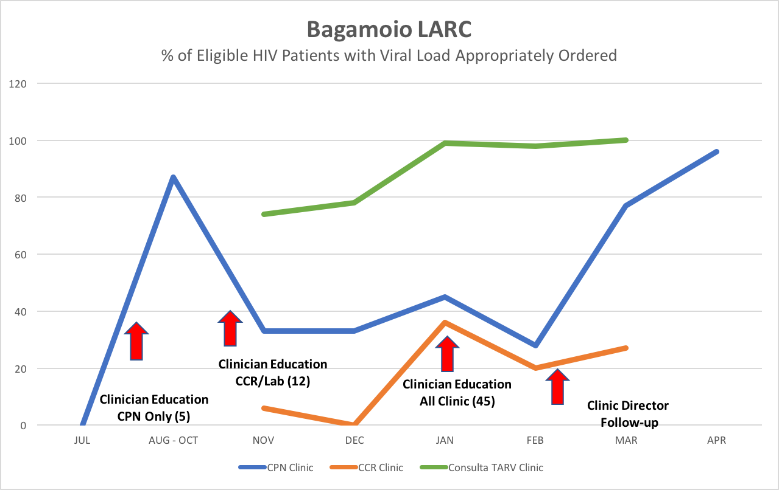
Visual – “Graphs tell a story”

Slide 126
Metrics - When?
Define / Measure
  Problem Statement – the magnitude of the problem
  Aim Statement – the project goals & outcomes
Analyze
Improve
  Question #2 – How will you know if a change is an improvement?
  Question #3 - Which change will you make that will result in an improvement?
Control
  Monitoring over time
  Assuring long-term sustainability

Slide 127
Types of Measures
INPUTS
Input #1
Input #2
Input #3
Process Step
A
Process Step
B
OUTCOME
Process Step
C
Input Measures
Process Measures
Outcome Measures
Counterbalance Measures
Notes:
You can select measures for inputs and outputs for the ED Simulation
Inputs – Patients, Supplies, Staff, Physical Structure
Outputs – # Patients treated, Patient satisfaction,
Process steps – Time, Quality of step

Slide 128
Metric Selection
“Measure what matters”
Notes:
Data to align with strategic goals
Data that is available and valid
Data with an available benchmark / comparison data

Slide 129
Metric Selection
Searching for the “Holy Grail” – The Ideal Metric
  Measure the outcome - what the project is attempting to accomplish
  Be powerful
  Be meaningful
  Be realistic or easy to collect
Metric Selection Questions (See Model for Improvement – 3 Questions)

Slide 130
What are some things that you can measure?
Time, i.e. length of stay, TAT, wait-time, or time between episodes
Defects (Errors)
Counts - i.e., numbers of patients or _________
Scores, i.e. Satisfaction
Efficiency
Productivity
Safety
Compliance
Cost
Value
Throughput / Flow
Access

Slide 131
Getting to your aim statement and metric
Accomplish?
Measure?
Accomplish?
Measure?
An iterative process

Slide 132
Getting to your aim statement and metric
Accomplish?
Measure?
Accomplish?
Measure?
Goal = All patients viral load suppressed
An iterative process
Can I measure that given the time frame of this project?
Goal = High viral load results clinically acted upon
What does that mean?
How am I going to measure that?
What is my numerator & denominator?

Slide 133
Key Elements of a Metric
NUMERATOR
DENOMINATOR

Slide 134
Where to find data?
Data present currently, sources could include:
  Data bases
  Ongoing projects
  Ministry of Health – Written log or electronic records
  Partners/NGOs
Data not present, must collect:
  Data Collection Log – Create & Modify
  Data Collection Plan – Details
    What / How / When / Who

Slide 135
Creating a Data Collection Log

Slide 136
Creating a Data Collection Plan - Template

Slide 137
Data Collection Plan - Example

Slide 138
Deliverables
Metric - Selected & Defined
Data Collection Tool
Data Collection Plan
Data Display
Workbook, p. 48-55

Slide 139
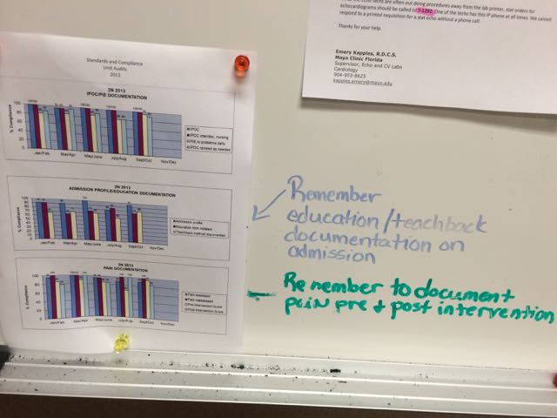
Coming Attractions:
Data Display
Be transparent – display data prominently

Slide 140



Slide 141



Slide 142



Coming Attractions: Creating a Run Chart
Workbook, p. 55

Slide 143
Coming Attractions:
Using your Data
Act on information

Slide 144
The LARC Quality Improvement Collaborative:
Learning Session I
How to be a Quality Ninja
ANALYZE
LARC

Slide 145
ANALYZE
Root Cause Analysis
Fishbone / Cause & Effect / Ishikawa Diagram
5 Whys
Pareto Diagram
Workbook, p. 56-62

Slide 147

Fishbone
Diagram
Workbook, p. 59

Slide 148

Categories to Review for Potential Causes
6 Ms
Man (People)
Methods (Policy/Procedure)
Materials (Supplies)
Mother Nature (Environment)
Measurement (Process)
Machine (Equipment)

Slide 149

5 Whys
Workbook, p. 57

Slide 150

Pareto
Diagram
Workbook, p. 61

Slide 151


Pareto Table/
Diagram

Slide 152

Spaghetti Diagram
Workbook, p. 75

Slide 153

Spaghetti Diagram

Slide 154
Session 1 Deliverables
DEFINE / MEASURE / ANALYZE
Identify Stakeholders
Team Formation
Map the Process (Current)
ID / Prioritize Opportunities
  Project Outline
Baseline Metrics - Data Collection Tool/Plan
Action Plan
Elevator Speech
VOC Information
Root Cause Analysis
1 Rapid/Small Test of Change (PDSA)
Presentation

Slide 155
See you next time!

